Slide 7
SCALING SANTA

Slide 8
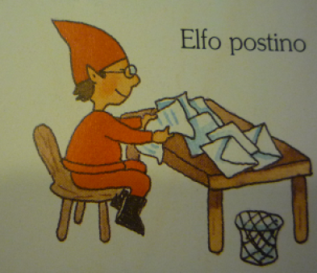
Distributed systems

Slide 9
Distributed santas systems
Why have architects struggled with decisions in distributed architectures?
Because Software Architecture is the stuff you can’t Google Bing answers for
Don’t try to find the best design in Software Architecture, instead strive for the least worst combination of trade-offs

Slide 10
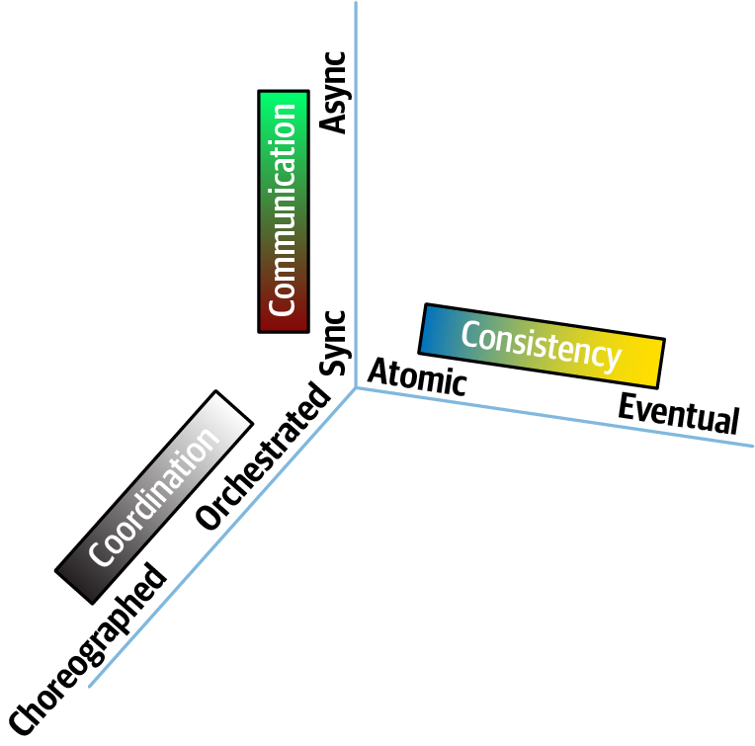
Distributed Forces

Slide 11
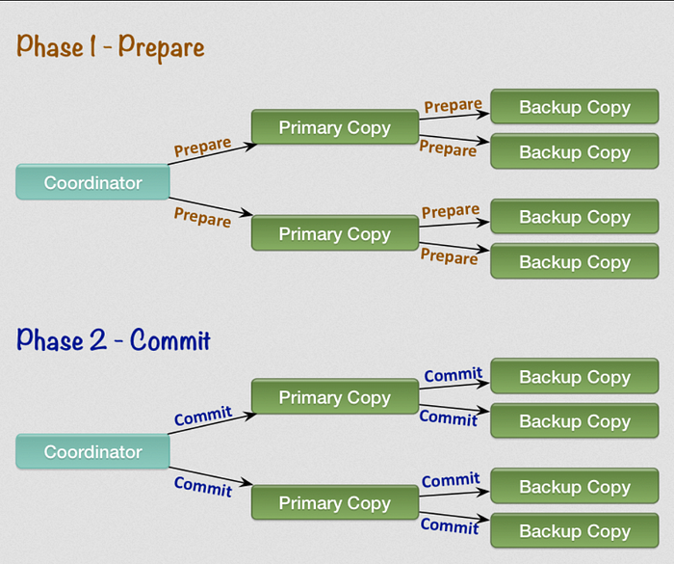
2 phase commit

Slide 12
Transactional saga
Pattern Name |  | Communication | Consistency | Coordination
Epic Saga | SAO | Synchronous | Atomic | Orchestrated
Phone Tag Saga | SAC | Synchronous | Atomic | Choreographed
Fairly Tale Saga | SEO | Synchronous | Eventual | Orchestrated
Time Travel Saga | SEC | Synchronous | Eventual | Choreographed
Fantasy Fiction Saga | AAO | Asynchronous | Atomic | Orchestrated
Horror Story | AAC | Asynchronous | Atomic | Choreographed
Parallel Saga | AEO | Asynchronous | Eventual | Orchestrated
Anthology Saga | AEC | Asynchronous | Eventual | Choreographed

Slide 13
Transactional saga
Pattern Name |  | Communication | Consistency | Coordination
Epic Saga | SAO | Synchronous | Atomic | Orchestrated
Phone Tag Saga | SAC | Synchronous | Atomic | Choreographed
Fairly Tale Saga | SEO | Synchronous | Eventual | Orchestrated
Time Travel Saga | SEC | Synchronous | Eventual | Choreographed
Fantasy Fiction Saga | AAO | Asynchronous | Atomic | Orchestrated
Horror Story | AAC | Asynchronous | Atomic | Choreographed
Parallel Saga | AEO | Asynchronous | Eventual | Orchestrated
Anthology Saga | AEC | Asynchronous | Eventual | Choreographed

Slide 14
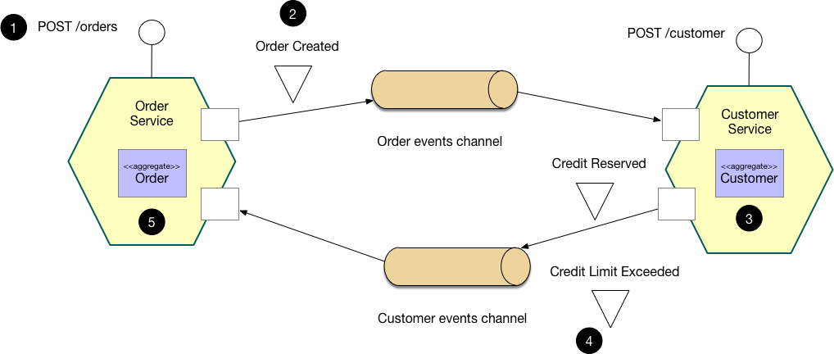
Choreography-based saga

Slide 15
Choreographed - Trade-offs
Adavantages
Disadavantages
Responsiveness
Distributed Workflow
Scalability
State Management
Fault Tolerance
Error Handling
Service Decoupling
Recoverability

Slide 16
Saga choreography

Slide 17
Anthology saga - ratings
Anthology Saga (aec)
Ratings
Communication
Asynchronous
Consistency
Eventual
Coordination
Choreographed
Coupling
Very low
Complexity
High
Responsivenes/Availability
High
Scale/Elasticity
Very high

Slide 18
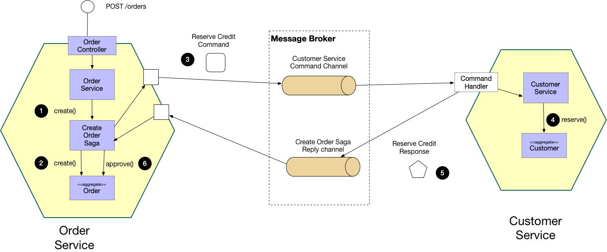
orchestrator-based saga

Slide 19
Orchestrator - Trade-offs
Adavantages
Disadavantages
Centralized Workflow
Responsiveness
Error Handling
Fault Tolerance
Recoverability
Scalability
State Management
Service Coupling

Slide 20
Saga ORCHESTRATOR

Slide 21
parallel saga - ratings
Anthology Saga (aec)
Ratings
Communication
Asynchronous
Consistency
Eventual
Coordination
Orchestrated
Coupling
Low
Complexity
Low
Responsivenes/Availability
High
Scale/Elasticity
High

Slide 22
In a message-based system, we might feel a lack of control, especially when in need of compensating changes spread across the system. Fear not! Real life deals with compensation every day! And it's better than rolling back a transaction or deleting some data in the database. Compensation is all around us.

Slide 23
Thank you
alberto.acerbis@intre.it
https://github.com/Ace68/XmasDev2023

