Slide 2
Blazor e i Long Running Process
Alberto Acerbis

Slide 4
Saga: a long story of heroic achievement

Slide 5
What is a Long Running Process?

Slide 6
Orchestrator

Slide 7
Choreography

Slide 8
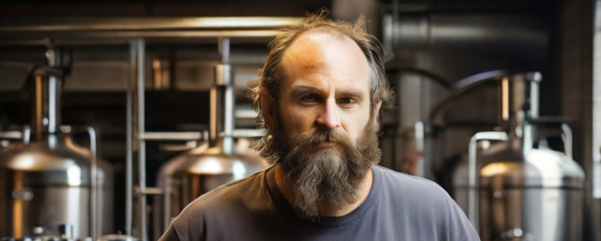
What is the best choice?

Slide 9
Trade-Offs
Orchestration
Choreography
Advantage | Disadvantage
Centralized workflow | Responsiveness
Error handling | Fault tolerance
Recoverability | Scalability
State management | Service coupling
Advantage | Disadvantage
Responsiveness | Distributed workflow
Scalability | State management
Fault tolerance | Error handling
Service decoupling | Recoverability

Slide 10
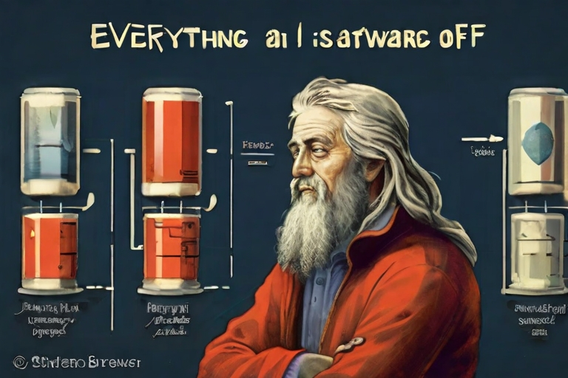
Everything in Software Architecture is a Trade-Off

Slide 11
Three Forces
Coordination
Orchestrator
Choreography
Communication
Synchronous
Asynchronous
Persistence
Atomic
Eventually

Slide 12
Why We Need It?
Often with the same outcome (Neal Ford)
Developers are drawn to complexity,
like moths to a flame

Slide 13
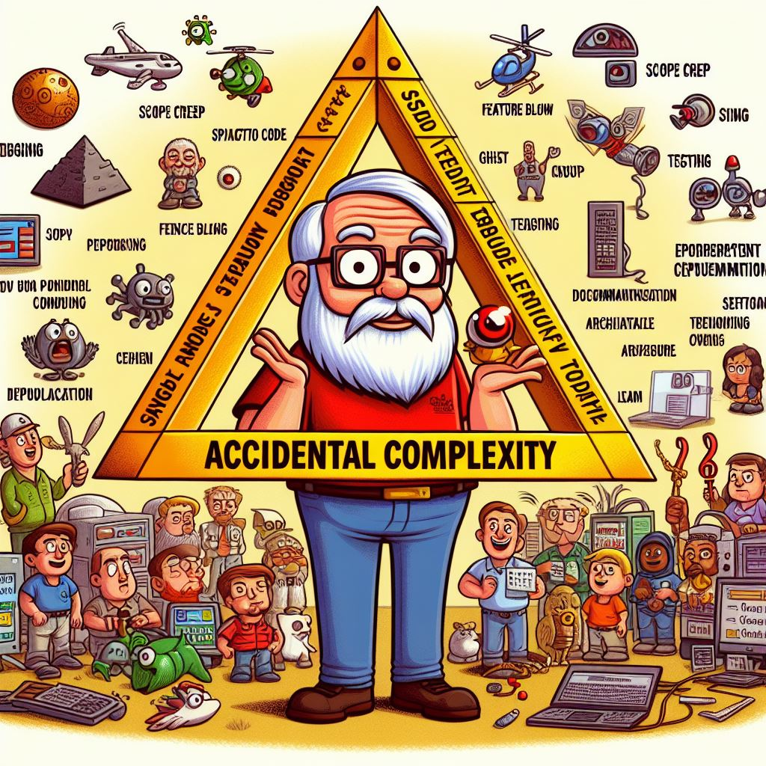
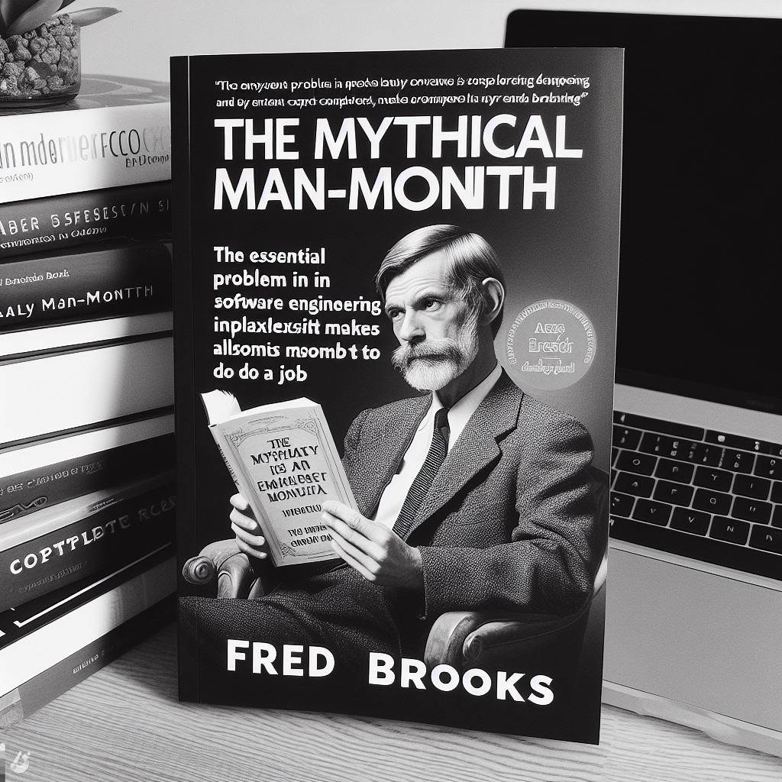
What is Complexity?
Essential
Accidental

Slide 14
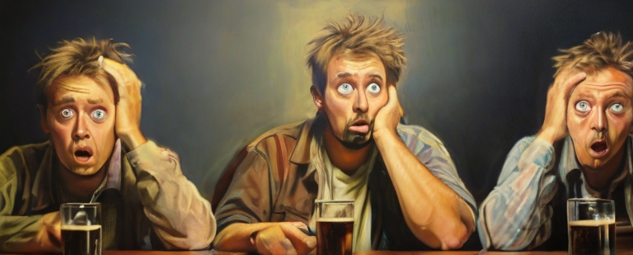
How do we keep the UI up-to-date?

Slide 15
What is SignalR?
SignalR lies on top of the lower-level transports

Slide 16
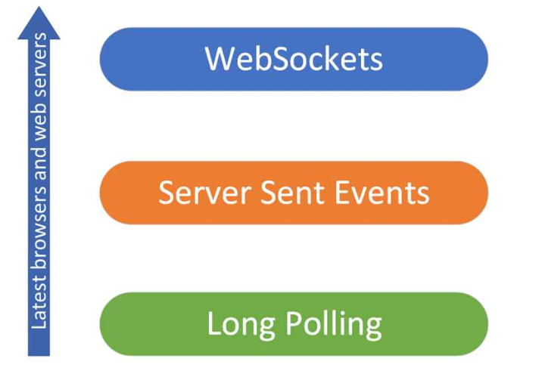
Focus on business process
SignalR can dynamically evaluate the supported transports

Slide 17
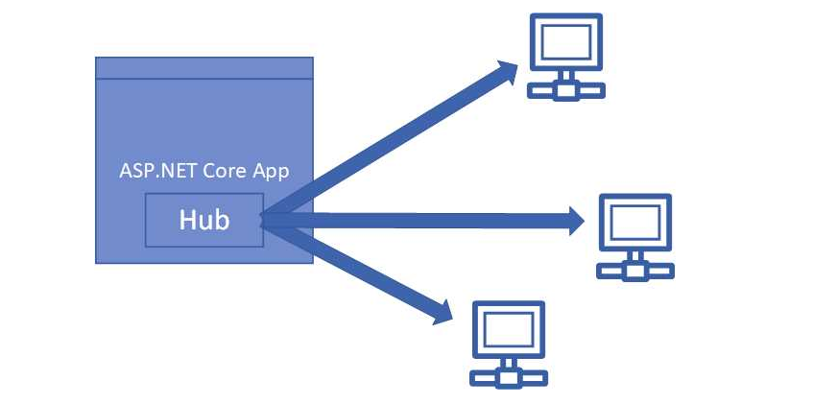
SignalR Hub

Slide 18
Demo

Slide 19
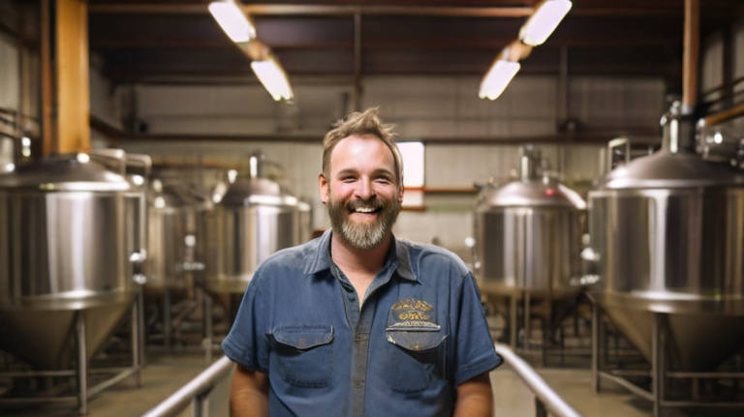

Slide 20
Further Readings
Download .NET 8 aka.ms/get-dotnet-8
Introducing to signalR Microsoft Documentation
signalR outside the hub Send messages outside a hub
Software Architecture: The Hard Parts O’Reilly

Slide 21
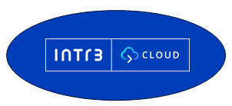
Thanks
https://agilereloaded.it/corsi/corso-ddd-teoria-pratica/
alberto.acerbis@intre.it
https://github.com/Ace68/1nn0va-NetConf2023
Alberto Acerbis

