Slide 1

Using .NET and Azure
to Build & Deploy
Microservices Architectures
Aka : Evolutionary Architectures
Alberto Acerbis

Slide 2

The lowest level of knowledge is when we make a lot of decisions about the future system
Microservices
Serverless
Monolithic
SOA
It’s easy to make things complicated, but it’s complicated to make them simple
(Gall’s Law)
EDA

Slide 3
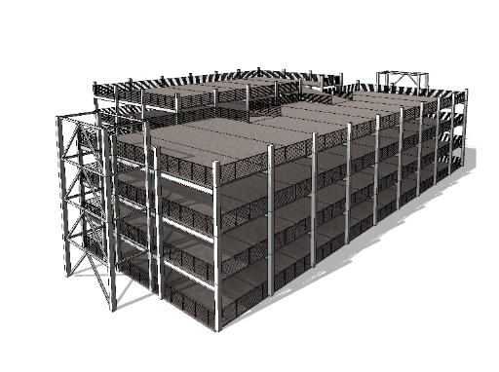
NewVantage Report
Evolutionary Architecture

Slide 4



NewVantage Report
Evolutionary Architecture
Incremental
Fitness Functions
Multiple Dimensions

Slide 5


All we need is Data!
Scenario
Purchases
Warehouse

Slide 6

Risk comes from not knowing what you are doing
(Warren Buffet)
Requirements not only focus on the solution and hide problems, but requirements also tend to translate business language to more technical language
The only way to decrease ignorance is to increase understanding

Slide 7
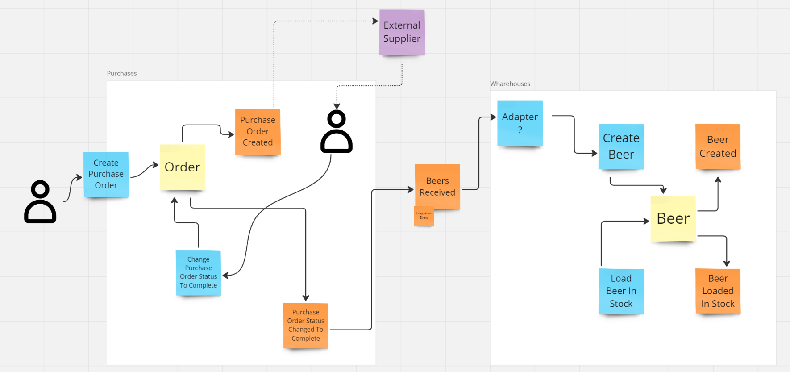
NewVantage Report
Domain Exploration

Slide 8

Hands On Time

Slide 9
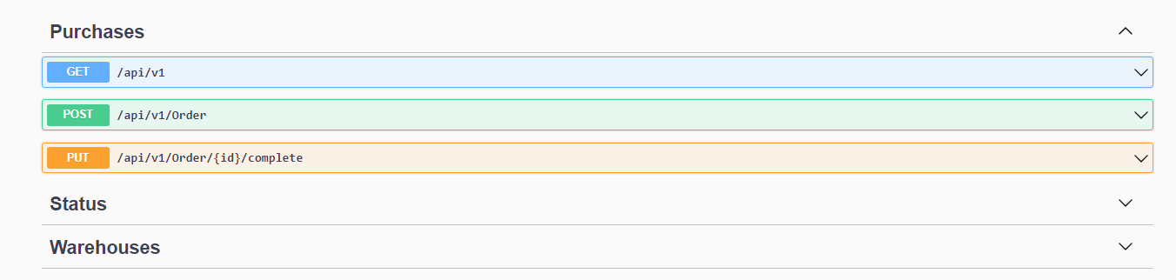
Hands-On Learning

Slide 10
Hands-On Learning
{
"Id": "637a01a3-c410-4072-851a-9d4fbebda01d",
"SupplierId": "e3e15038-b790-43d8-8e8c-5c496b4cff95",
"Date": "2023-07-07T00:00:00.0000000+02:00",
"Lines": [
{
"ProductId": "ddfe87ff-e5c9-4cb4-bb07-32d6e420d2c7",
"Title": "Muflone IPA",
"Quantity": {
"Value": 10,
"UnitOfMeasure": "N."
},
"Price": {
"Value": 7,
"Currency": "EUR"
}
}
]
}

Slide 11

Share the code

Slide 12
Monolithic vs Microservices
Easy Development
Performance
Simplified testing
Easy debugging
Easy deploy
Agility
Flexible scaling
Continuous deployment
Highly maintainability and testable
Independently deployable
Technology flexibility
High reliability
26/07/2023 – WeAreDevelopers

Slide 13
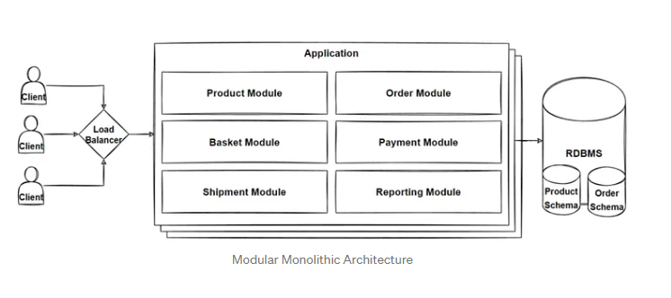
Evolutionary Architecture

Slide 14
Failure Symptoms
DDD
Module
Low Coupling
  Each module should be independent of other modules in the system
High Cohesion
  Components of the module are all related thus making it easier to understand what module does as a self-contained subsystem (SRP)
Choosing Modules
  Tell the story of the system
  Contain cohesive set of concepts
  Have meaningful names that become part of the Ubiquitous Language

Slide 15
Failure Symptoms
Git
Clone
Clone this https://github.com/Ace68/WeAreDevelopers-2023

Slide 16
Show me the code
Notes:
Time is a hard master

Slide 17
Azure AppService provides fully managed hosting for web applications including websites and web APIs
AKS
App Service
Container App
Azure Kubernetes Service (AKS) provides a fully managed Kubernetes option in Azure
Azure Container Apps enables you to build serverless services based on containers
Notes:
Time is a hard master

Slide 18



Slide 19


Misintegration
References
Neal Ford, Rebecca Parsons, Patrick Kua
Building Evolutionary Architectures
Neal Ford, Mark Richards, Pramod Sadalage, Zhamak Dehghani
Software Architecture: The Hard Parts
26/07/2023 – WeAreDevelopers

Slide 20







whoami
alberto.acerbis@intre.it
https://github.com/brewup
https://github.com/cqrs-muflone
https://github.com/Ace68/WeAreDevelopers-2023
https://www.twitch.tv/dddbrewup
26/07/2023 – WeAreDevelopers

