Slide 1
Blazor and Distributed Systems
Alberto Acerbis

Slide 2
Un grazie agli sponsor

Slide 3
Why Event-Driven Microservices

Slide 4
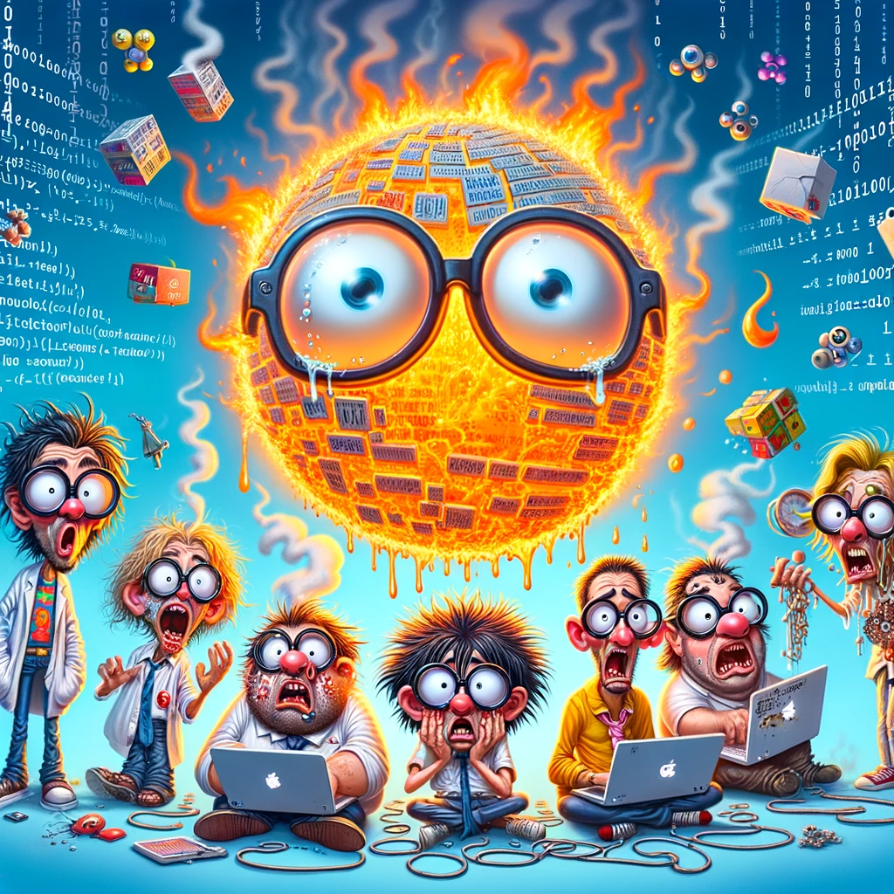
“Developers are drawn to complexity, like moths to a flame, often with the same outcome”
Neal Ford

Slide 5
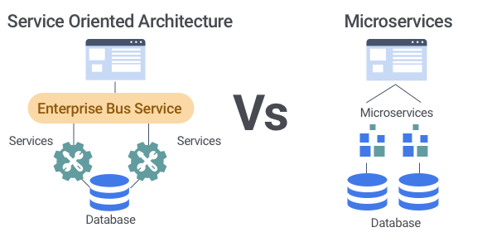
SOA
vs Microservices
Cloud

Slide 6
OOP Principles
Everything is an Object
Objects communicate by sending and receiving messages
Objects have their own memory
The class holds the shared behavior for its instances
To eval a program list, control is passed to the first object and the remainder is treated as its message
Alan Kay - SmallTalk

Slide 7
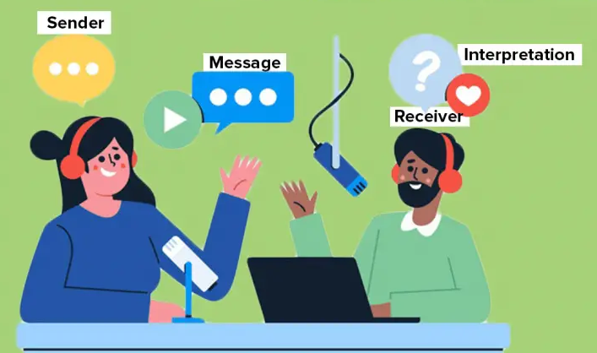
What is Communication?
Communication is the process of passing information (sending) and understanding (receiving) the same from one service to another.

Slide 8
What is Communication?
Communication is the process of passing information (sending) and understanding (receiving) the same from one service to another.

Slide 9
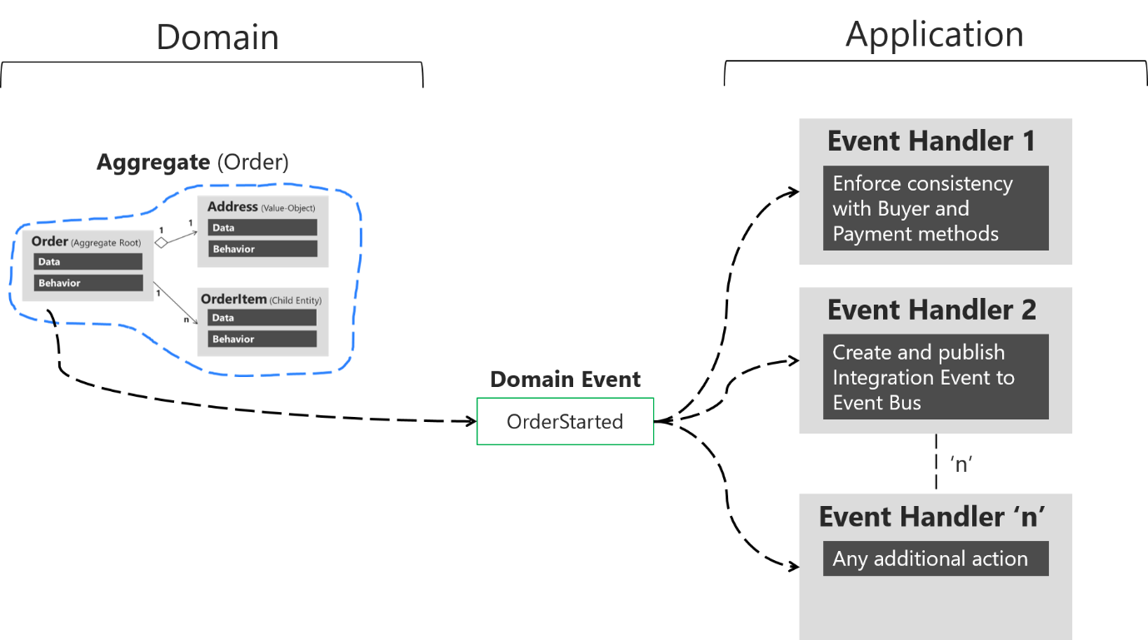
Domain Event

Slide 10
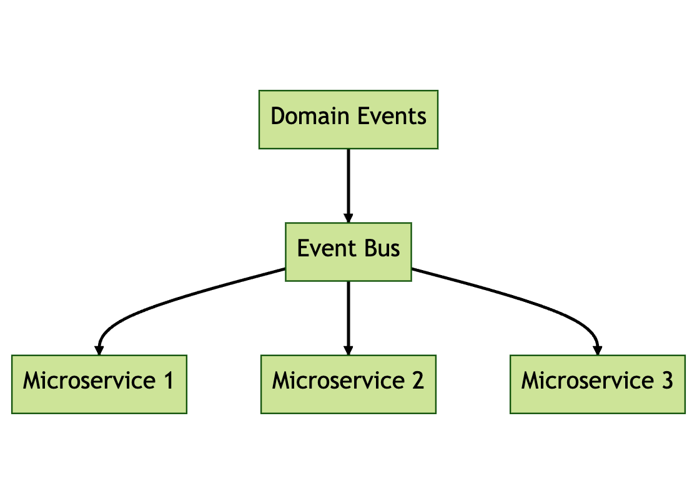
Don’t Try It at Home!

Slide 11
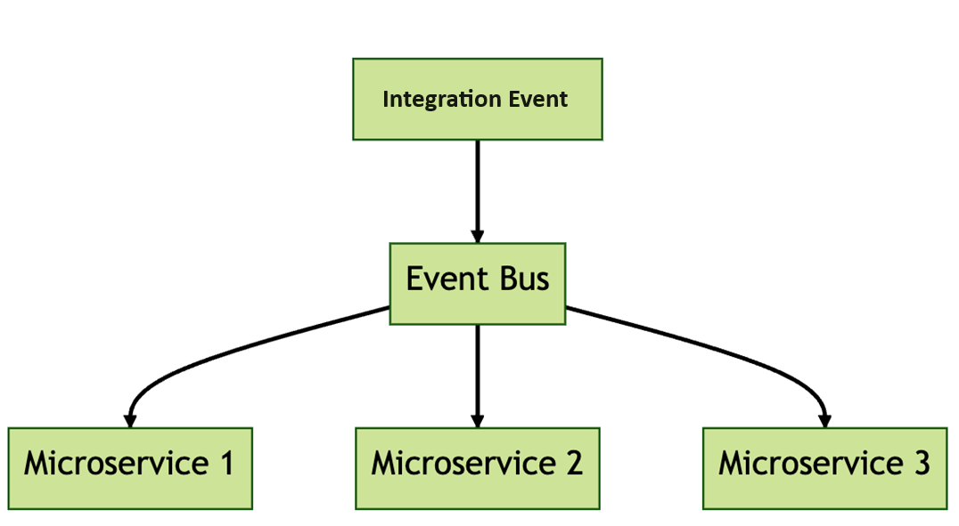
Integration Event

Slide 12
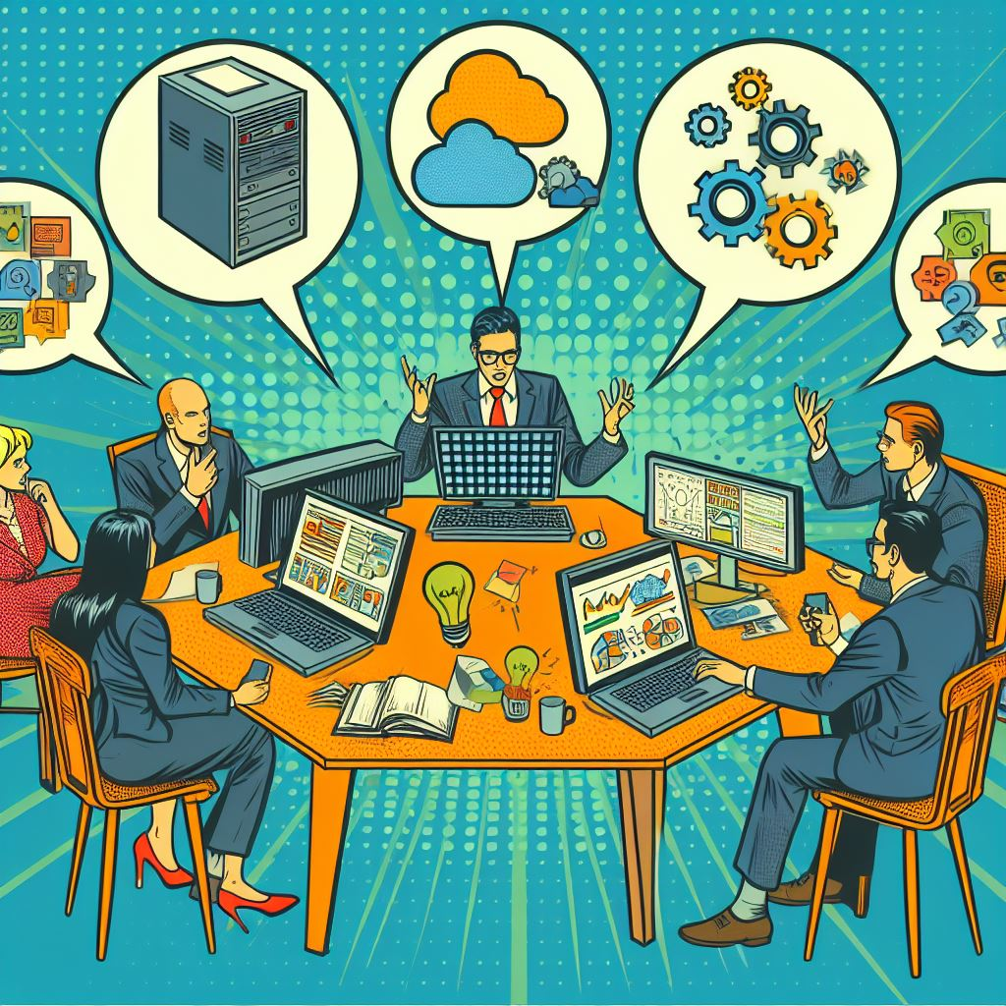
Distributed System
&
Transactions

Slide 13
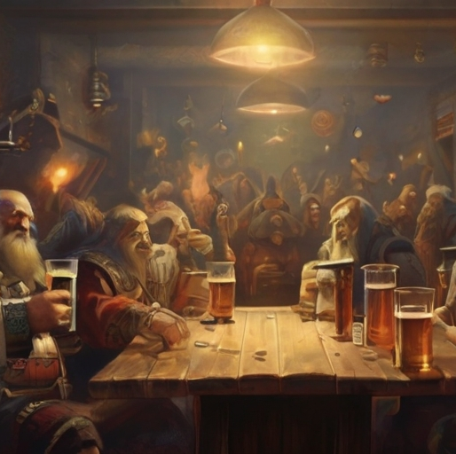
Saga A long story of heroic achievement

Slide 14
What is a Long Running Process?

Slide 15
Long Running basically means Waiting!

Slide 16
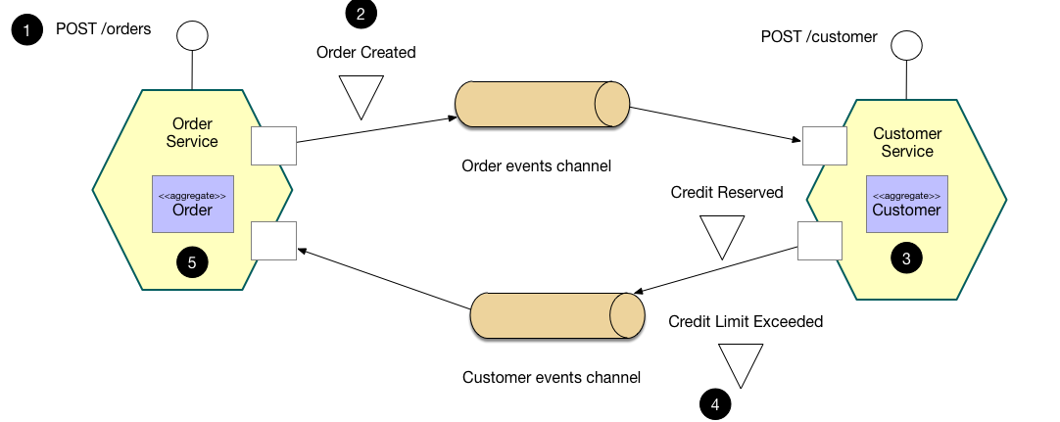
Choreography
microservice.io

Slide 17
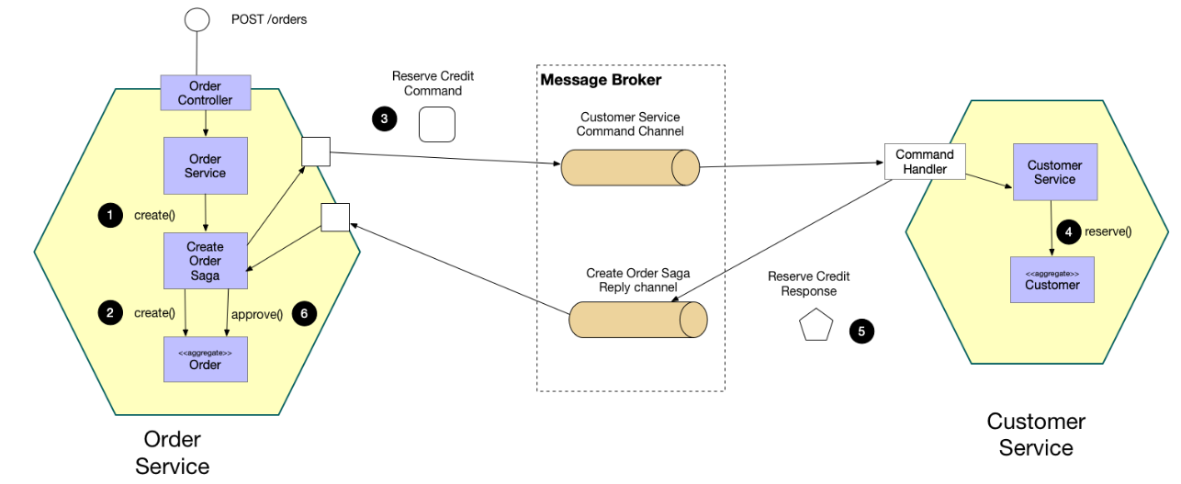
Orchestrator
microservice.io

Slide 18
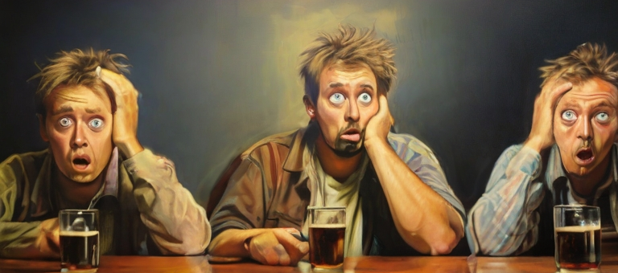
How do we keep the UI up-to-date?

Slide 19
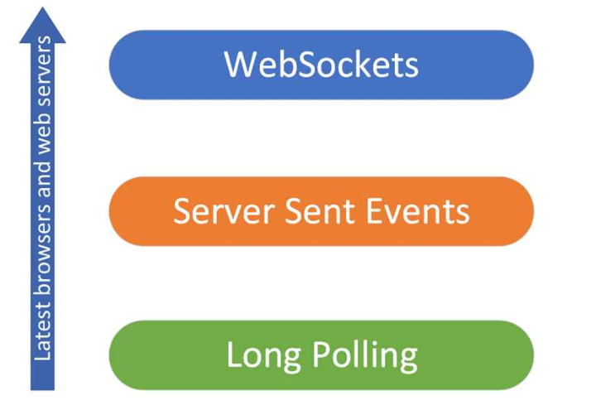
Focus on business process

Slide 20
Demo
Quando i servizi non fanno esattamente quello che ti aspetti …

Slide 21
Further Readings
Download .NET 8 aka.ms/get-dotnet-8
Introducing to signalR Microsoft Documentation
signalR outside the hub Send messages outside a hub
Software Architecture: The Hard Parts O’Reilly

Slide 22
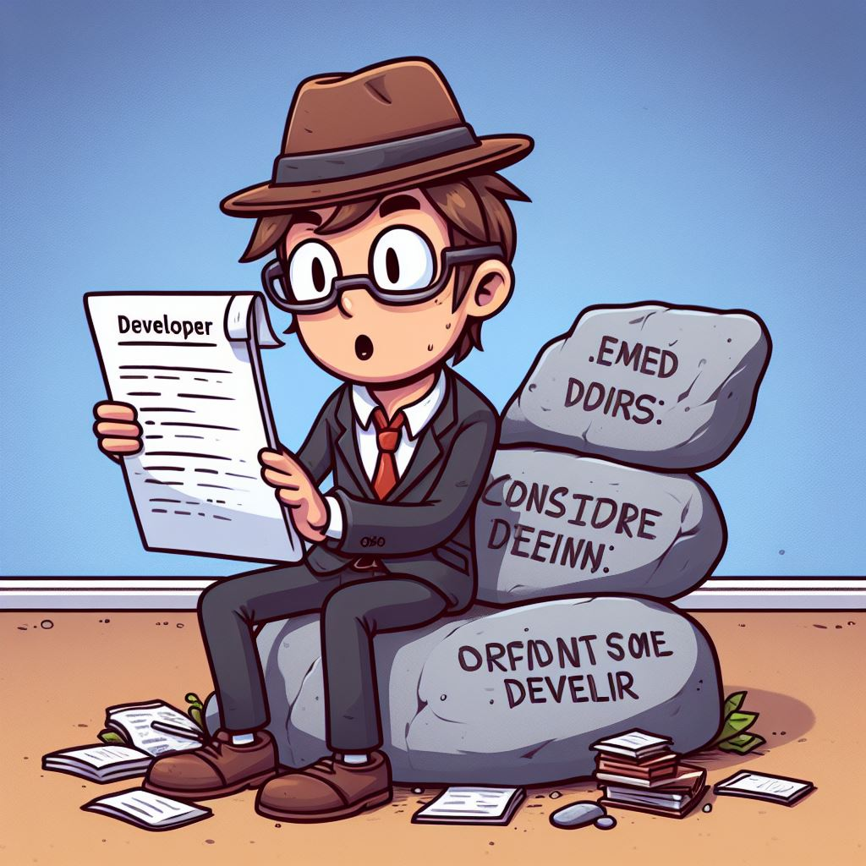
Thank You
alberto.acerbis@intre.it
https://github.com/Ace68/BlazorAndDistributedSystems
https://github.com/ace68

