Slide 1
The bounded context is not enough!
Alberto Acerbis – Alessandro Colla

Slide 2
Disclaimer
The "Bounded context" is needed, but in our opinion is not just a business transactional boundary anymore. We must keep in consideration its evolution and the static coupling with the infrastructure.
Notes:
A voce diremo che il BC deve tenere in considerazione la sua evoluzione e l’accoppiamento statico con l’infrastruttura

Slide 3
github.com/BrewUp/DDD-Explore-2024
All the code you will see today

Slide 4
Awful monolith
Show me the code

Slide 5
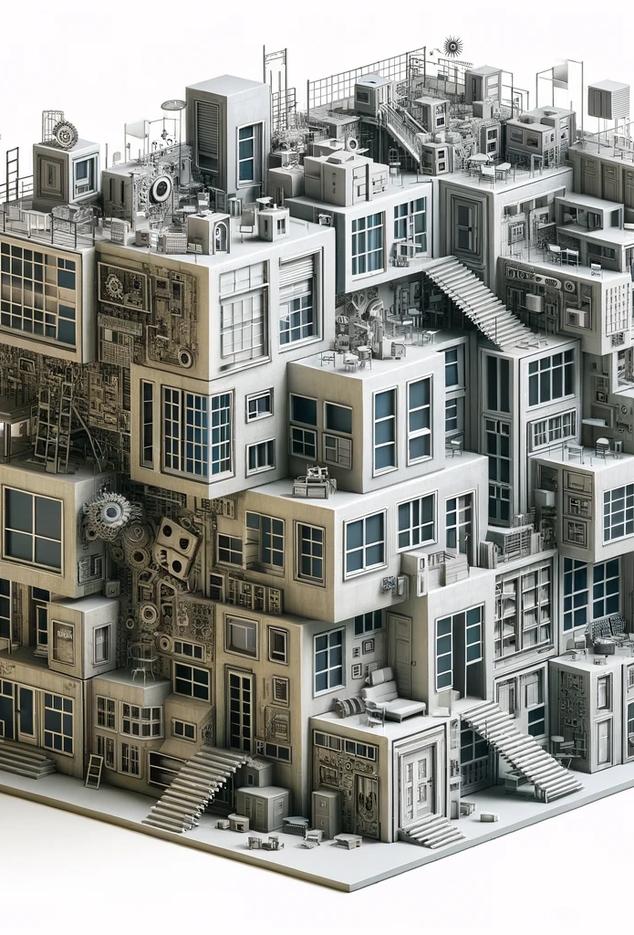
Big ball of mud
Lack of a clear architecture, leading to a system that is haphazardly structured and difficult to understand or modify.

Slide 6
Tight Coupling / Cyclic dependencies between components
Components are heavily interdependent, making changes in one part of the system likely to break other parts.

Slide 7
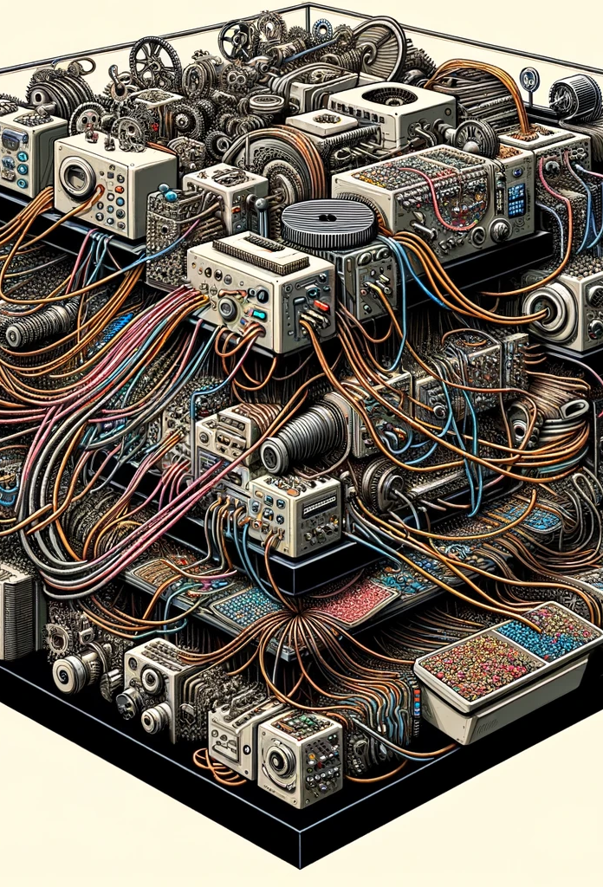
Lack of modularity
Failure to properly encapsulate different functionalities, leading to a system where changes in one module ripple through others.

Slide 8
Shared data model
Different modules or functionalities directly accessing and modifying a shared data model, leading to high risk of data corruption and conflicts.

Slide 9
Monolithic database design
A single database for all application needs, creating a bottleneck and complicating any attempt to scale or separate concerns.

Slide 10
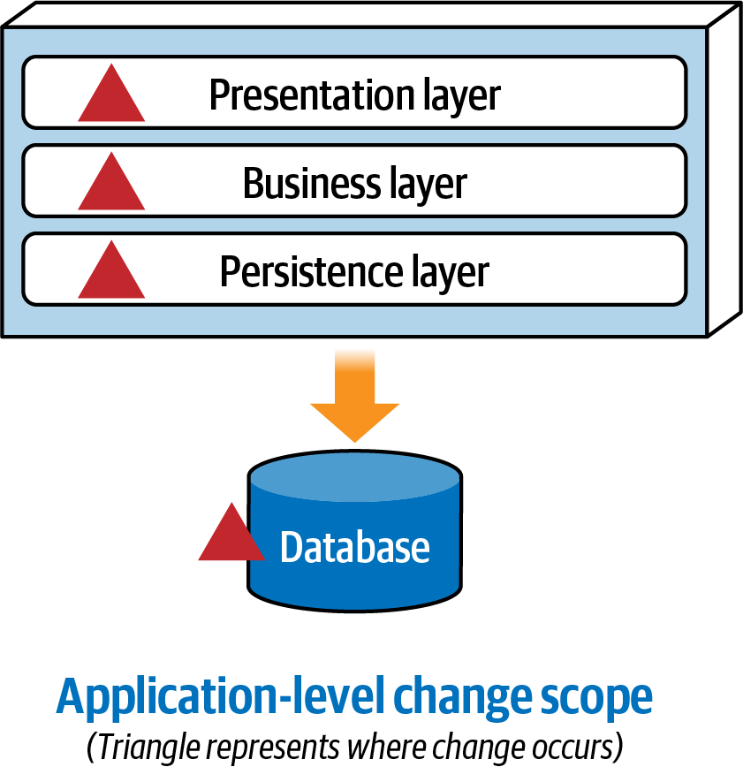
What is the impact of changes?
Neal Ford, Mark Richards, Pramod Sadalage, and Zhamak Dehghani

Slide 11
Exercise
How can we evolve it?
Notes:
Inseriamo il concetto di modulare (quantum architecture)

Slide 12
“Developers are drawn to complexity, like moths to a flame, often with the same outcome” - Neal Ford

Slide 13
Architecture decisions
We must understand the principles/key concepts to make effective decisions
Service: a cohesive collection of functionality deployed as an independent executable
Coupling: a change in one service might require a change in an another to maintain proper functionality
Component: building block of the application that does some sort of business or infrastructure function (e.g.: namespace or package)
Synchronous communication: the caller wait for the response before proceeding
Asynchronous communication: the caller does not wait for the response
Orchestrated coordination: it includes a service that coordinate the workflow
Choreographed coordination: it lacks an orchestrator
Atomicity: A workflow is atomic if all parts maintain a consistent state at all times (the opposite is eventual consistency)
Contract: the interface between two software parts
Notes:
Perché abbiamo fatto il monolite così? perchè ci sono scelte architetturali da tenere presente
For example, the decision between synchronous versus asynchronous communication has a number of trade-offs before architects layer in implementation details.

Slide 14
Modular (good) monolith
Show me the code

Slide 15
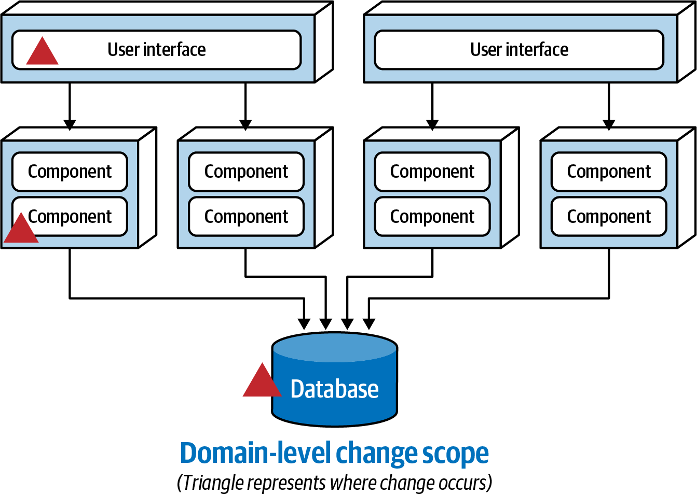
What is the impact of changes?
Neal Ford, Mark Richards, Pramod Sadalage, and Zhamak Dehghani

Slide 16
What we are missing next?
What we can add to make modules fully indipendent?

Slide 17
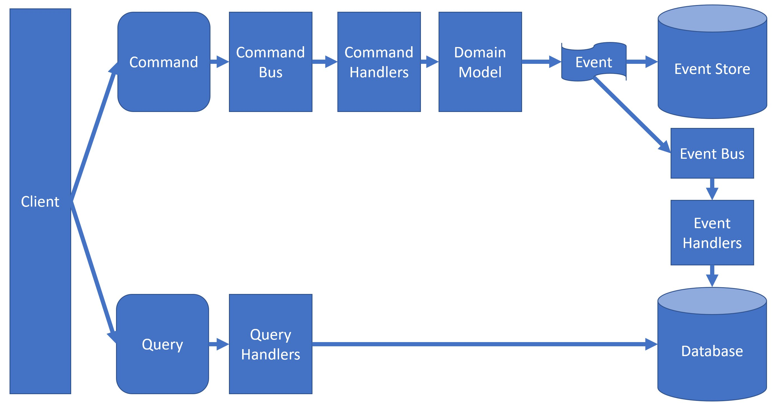
CQRS+ES

Slide 18
Exercise
Let’s work together with some live coding
Notes:
Inseriamo il concetto di modulare (quantum architecture)

Slide 19
Modular monolith with events
Show me the code

Slide 20
Fitness functions
The book «Building Evolutionary Architectures» defined the concept of an architectural fitness function
“any mechanism that performs an objective integrity assessment of some architecture characteristics or combination of architecture characteristics.”
Notes:
Chi mi garantisce l’evoluzione guidata della mia archiattura? Le fitness function -> test sull’architettura

Slide 21
Microservices
Show me the code

Slide 22
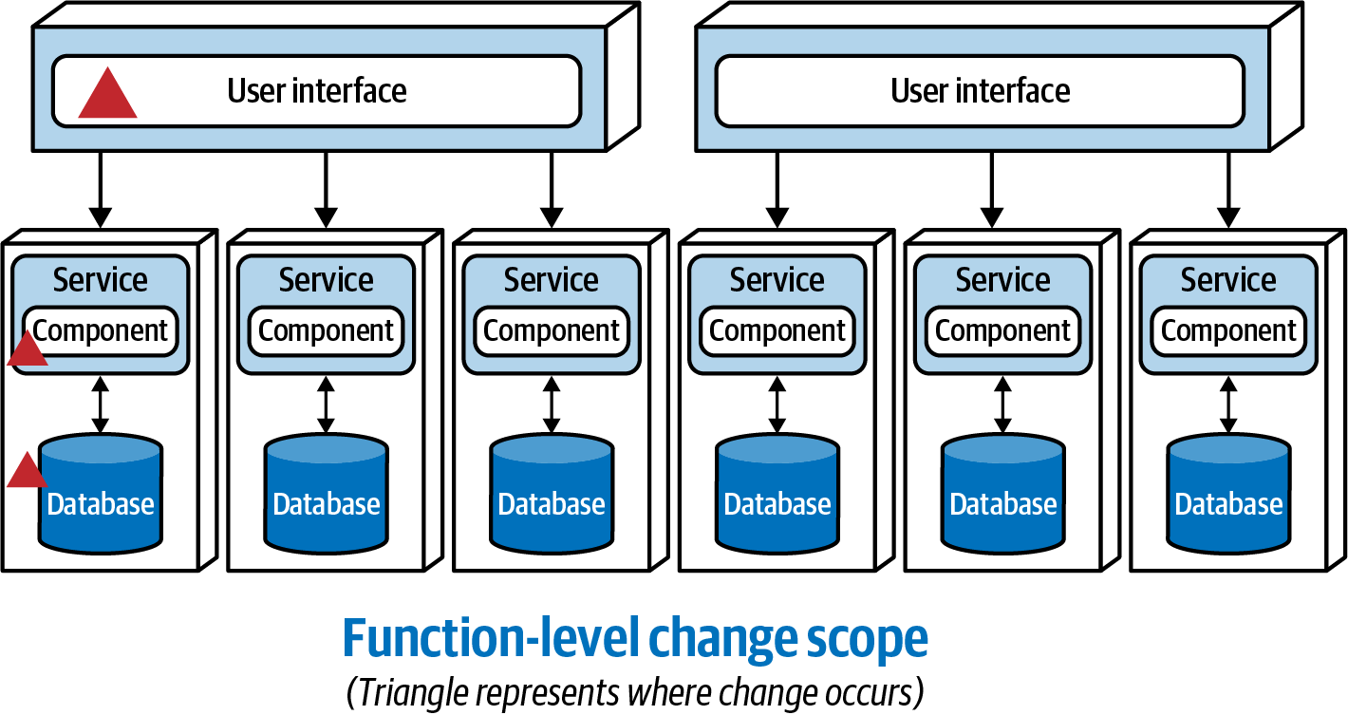
What is the impact of changes?
Neal Ford, Mark Richards, Pramod Sadalage, and Zhamak Dehghani
Notes:
Evidenziare che non c’è scritto Microservizio da nessuna parte

Slide 23
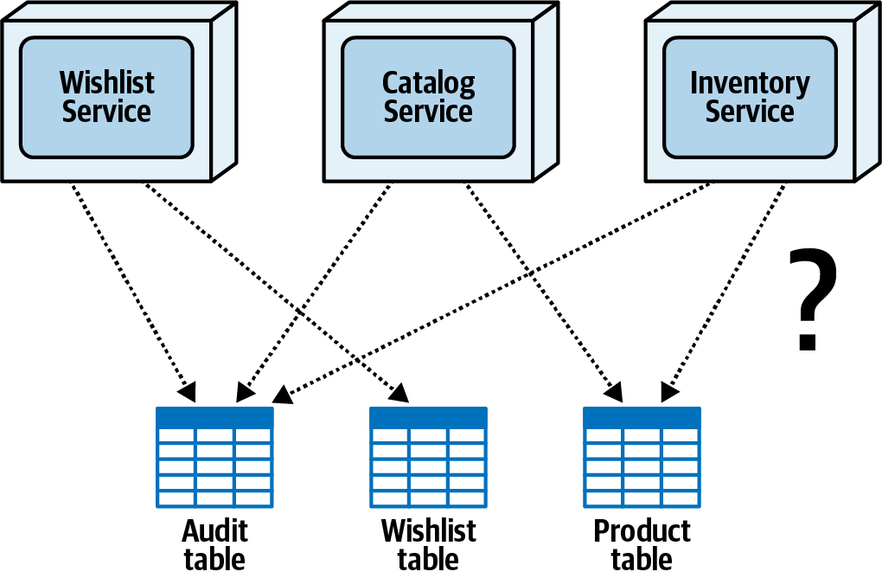
Well…How do I split my monolithic DB?
Common table
ownership
Single table
ownership
Joint ownership
Table split
Data domain
Delegate
Notes:
Single table ownership
Common table ownership (all services write to this DB)
Joint ownership (just two services write to this DB)

Slide 24
“Software architecture it's abstract by nature and we must ground it with some implementation details to make it concrete”

Slide 25
Architecture quantum|quanta
An architecture quantum measures several aspects of both topology and behavior in software architecture related to how parts connect and communicate with one another.
It is an independently deployable artifact with high functional cohesion, high static coupling, and synchronous dynamic coupling.

Slide 26
Bounded context is not enough
Transactional boundary is not enough as a concept.
We have to keep in consideration static and dynamic coupling of our components (e.g. DB, service bus, event store, etc.).
We like to see it as «components cohesion» like the concept of functional cohesion
Notes:
Functional cohesion: Refers structurally to the proximity of related elements: classes, components, services, and so on.

Slide 27
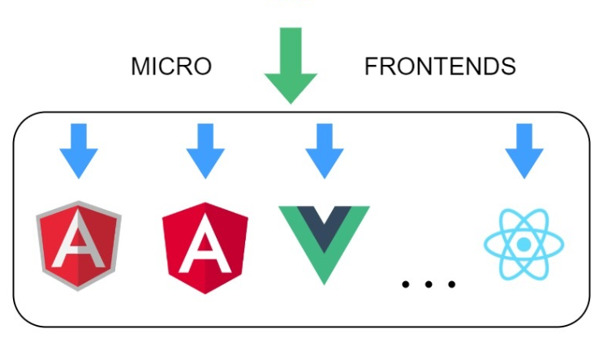
Components Cohesion
Notes:
Il BC originale senza gli altri elementi è limitato.

Slide 28
Components Cohesion
UI / API
Aggregate
Entities
Value objects
Etc.
Read Model
Events DB
Service bus
Notes:
Il BC originale senza gli altri elementi è limitato.

Slide 29
Last responsibility moment
«Delay decisions as long as you can, but not longer. Maximize the information you have. Minimize technical debt from complexity.»
Postel’s law or Robustness principle
“Be conservative in what you do, be liberal in what you accept from others”
Only validate what you need
Trade-off everywhere
«Don’t try to find the best design in software architecture.
Instead, strive for the least worst combination of trade-offs»

Slide 30
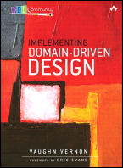
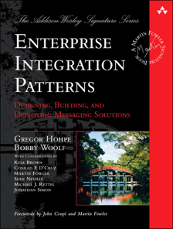
Bibliografia
Implementing Domain-Driven Design (V. Vernon) https://www.amazon.it/Implementing-Domain-Driven-Design-Vaughn-Vernon-ebook/dp/B00BCLEBN8/
Introducing Event storming (A.Brandolini) https://leanpub.com/introducing_eventstorming
REST in Practice: Hypermedia and Systems Architecture (J.Webber) https://www.amazon.it/REST-Practice-Hypermedia-Systems-Architecture/dp/0596805829
Enterprise Integration Patterns (G. Hohpe) https://www.amazon.it/Enterprise-Integration-Patterns-Designing-Deploying/dp/0321200683/
Learning Domain-Driven Design: Aligning Software Architecture and Business Strategy (Vlad Khononov) https://www.amazon.com/Learning-Domain-Driven-Design-Aligning-Architecture/dp/1098100131
Hands-On Domain-Driven Design with .NET Core (A. Zimarev) https://www.amazon.it/Hands-Domain-Driven-Design-NET/dp/1788834097
Software Architecture: The Hard Parts (N. Ford, M. Richards, P. Sadalage, Z. Dehghani) https://www.amazon.com/Software-Architecture-Trade-Off-Distributed-Architectures/dp/1492086894

Slide 32
You can find us at
@aacerbis
https://www.linkedin.com/in/aacerbis/
alberto.acerbis@intre.it
@collaalessandro
alessandrocolla
alessandro.colla@evoluzione.agency

