Slide 2
Design Patterns for Distributed Systems
Alberto Acerbis

Slide 3
A distributed system is a network of independent computers that work together as a single system to solve a problem or execute a task
In a distributed system, each computer, also known as a node, has its own memory and processing capabilities and communicates with other nodes through a network.
These systems are designed to distribute the workload among multiple nodes, which can lead to increased performance, fault tolerance, and scalability compared to centralized systems.

Slide 4
A distributed system is a network of independent computers that work together as a single system to solve a problem or execute a task
In a distributed system, each computer, also known as a node, has its own memory and processing capabilities and communicates with other nodes through a network.
These systems are designed to distribute the workload among multiple nodes, which can lead to increased performance, fault tolerance, and scalability compared to centralized systems.

Slide 5
Promise (and Perils) of Distributed Systems
Limits of a Single Server
Separate Business Logic and DataLayers
Partitioning Data
Failure Management

Slide 6
Architecture Evolution
Cloud
New Patterns
Components
Service
Oriented
Distributed Systems
Microservizi

Slide 8
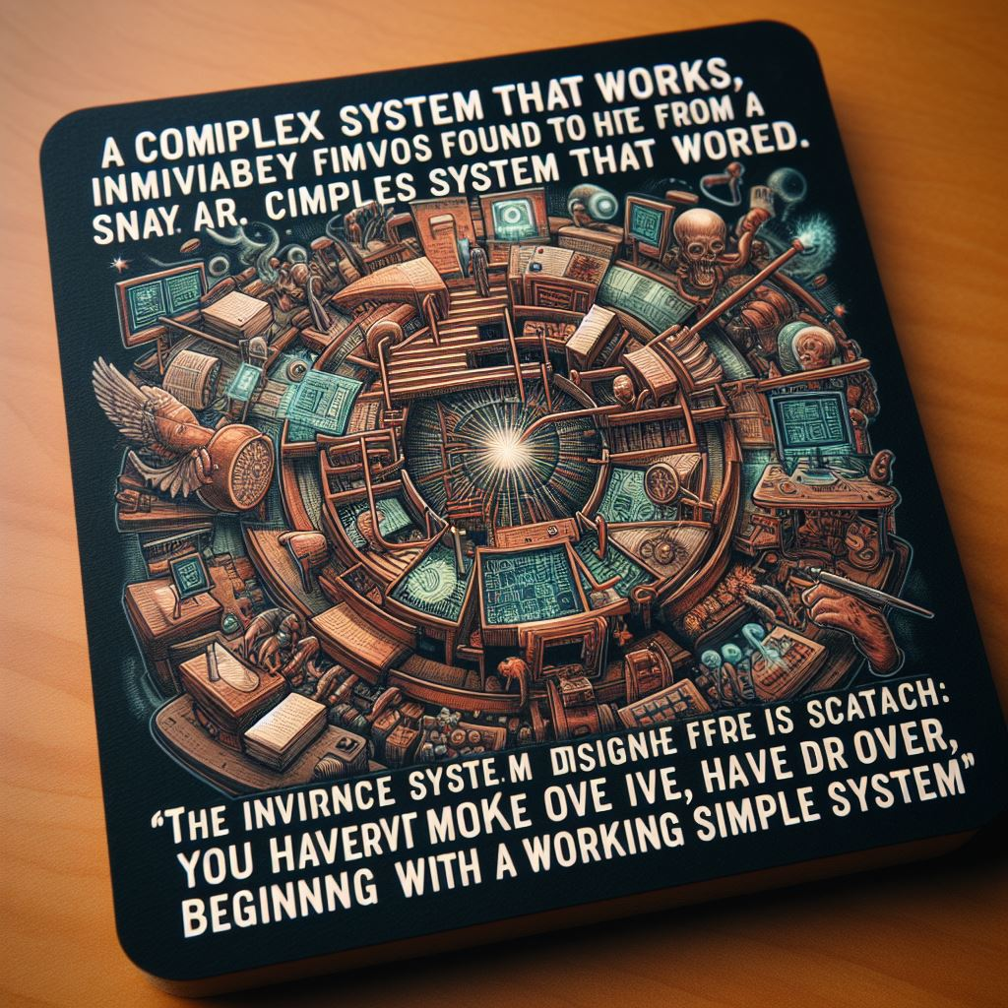
A complex system that works is invariably found to have evolved from a simple system that worked.
The inverse proposition also appears to be true: A complex system designed from scratch never works and cannot be made work.
You have to start over, beginning with a working simple system.
Gall’s Law

Slide 9
Promise (and Perils) of Distributed Systems
Separate Business Logic and DataLayers
Partitioning Data
Failure Management
Limits of a Single Server

Slide 10
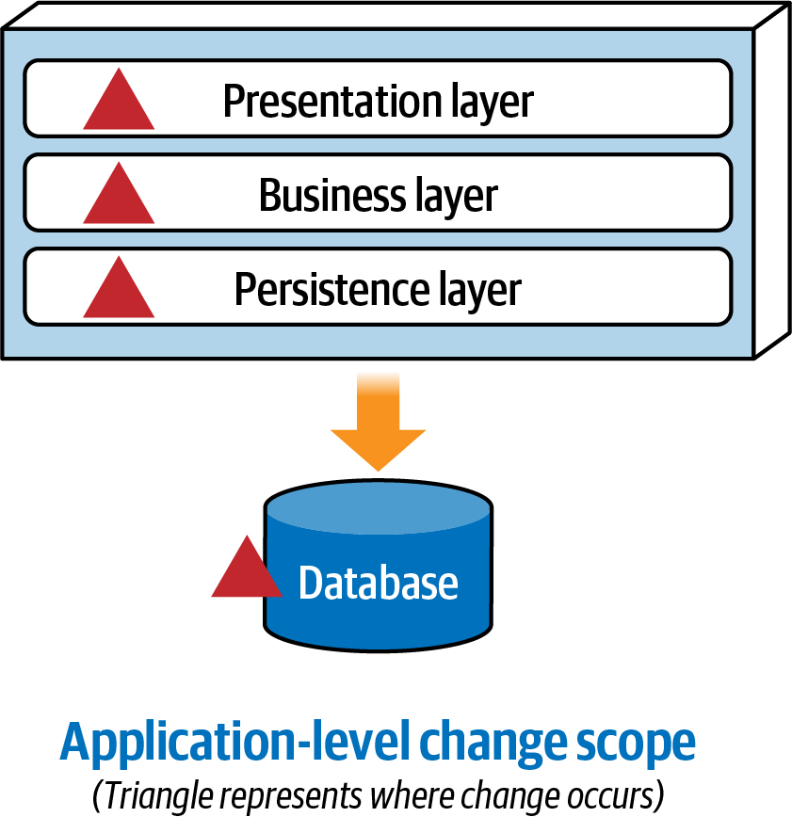
Separate Business Logic and Data Layer

Slide 11
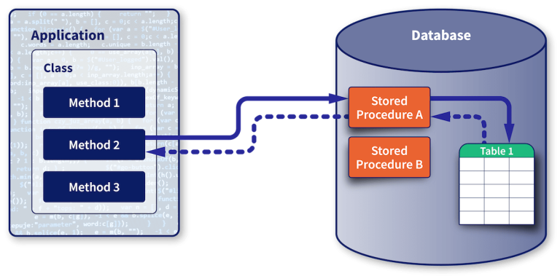
Separate Business Logic and Data Layer

Slide 12
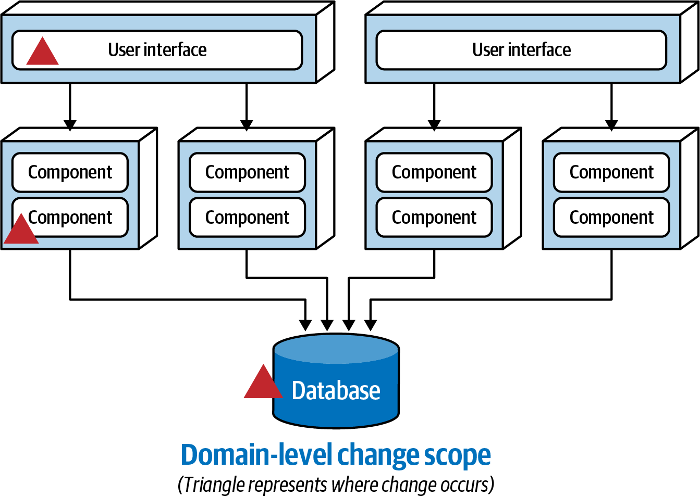
Separate Business Logic and Data Layer

Slide 14
Promise (and Perils) of Distributed Systems
Separate Business Logic and DataLayers
Partitioning Data
Failure Management
Limits of a Single Server

Slide 15
Partitioning Data
Given a distributed system has to update many components, it can’t simultaneously change everything at once, quickly, without failure.

Slide 16
Partitioning Data
Given a distributed system has to update many components, it can’t simultaneously change everything at once, quickly, without failure.
Partition Tolerance

Slide 17
Partitioning Data
Given a distributed system has to update many components, it can’t simultaneously change everything at once, quickly, without failure.
Consistency

Slide 18
Partitioning Data
Given a distributed system has to update many components, it can’t simultaneously change everything at once, quickly, without failure.
Availability

Slide 19
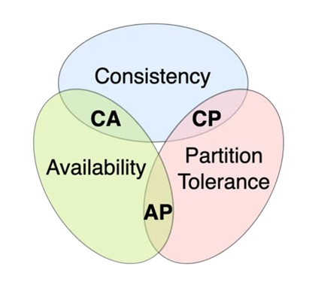
CAP Theorem
Any partition tolerant system can only have
consistency or availability.
Not both!
Consistency vs Availability

Slide 21
What is Communication?
Communication is the process of passing information (sending) and understanding (receiving) the same from one service to another.

Slide 22
What is Communication?
Communication is the process of passing information (sending) and understanding (receiving) the same from one service to another.

Slide 23
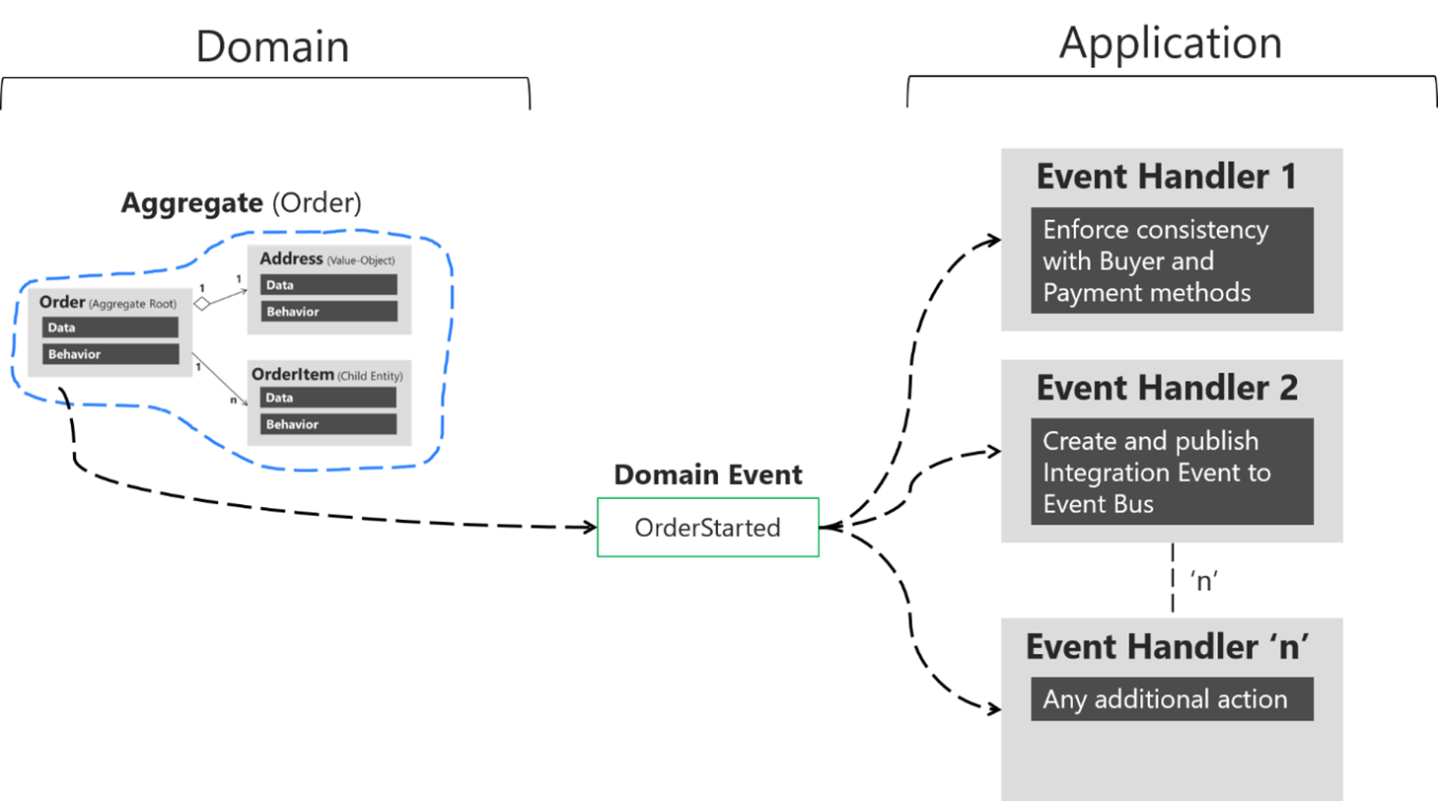
Domain Event

Slide 24
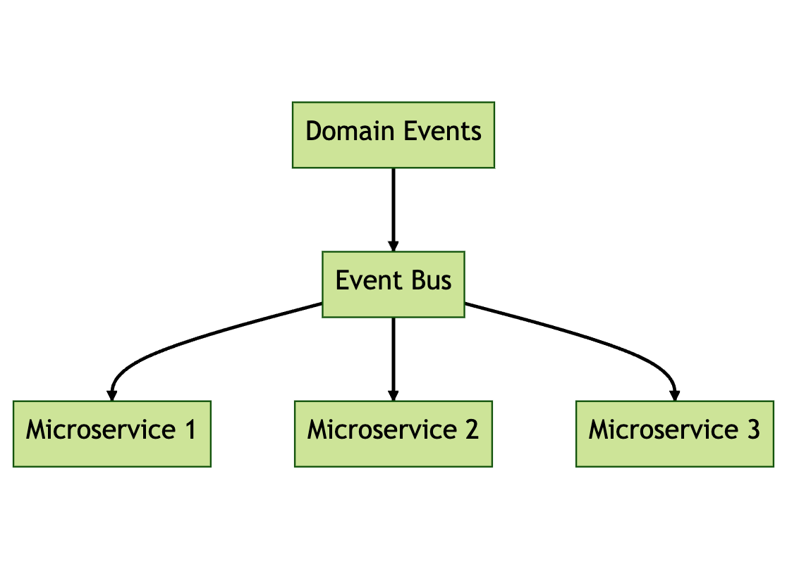
Don’t Try It at Home!

Slide 25
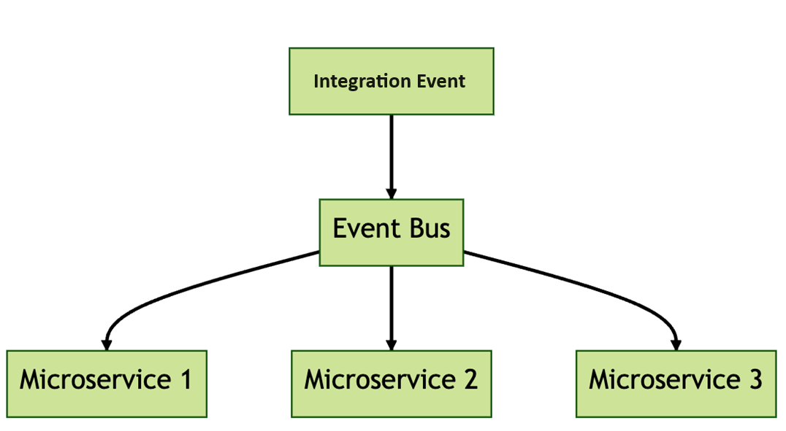
Integration Event

Slide 26
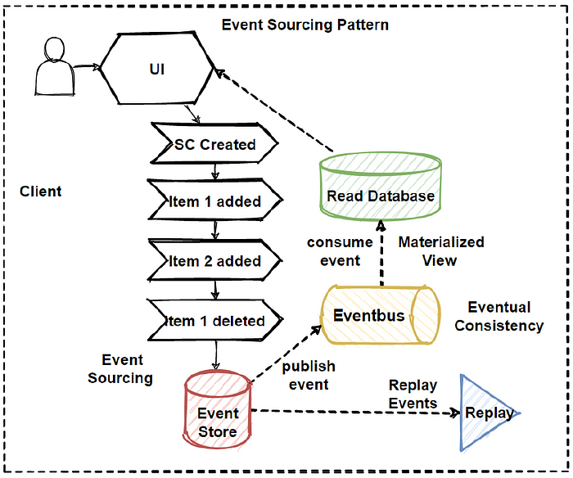

Slide 28
Promise (and Perils) of Distributed Systems
Separate Business Logic and DataLayers
Partitioning Data
Failure Management
Limits of a Single Server

Slide 29
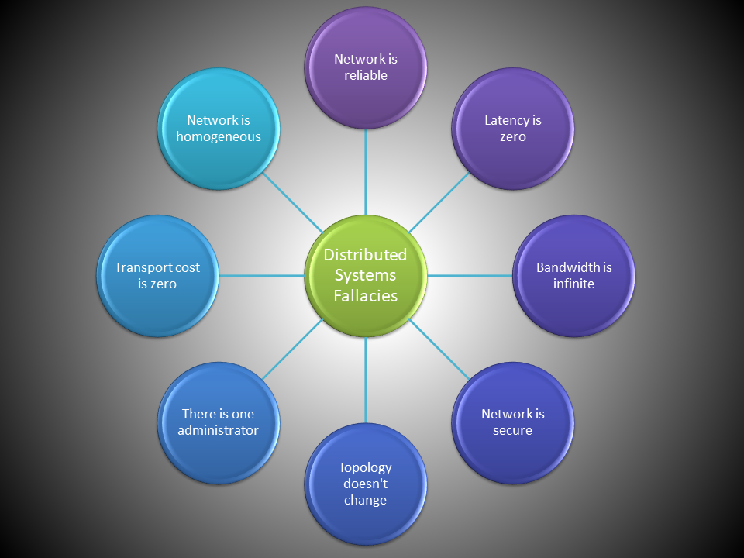

Slide 30
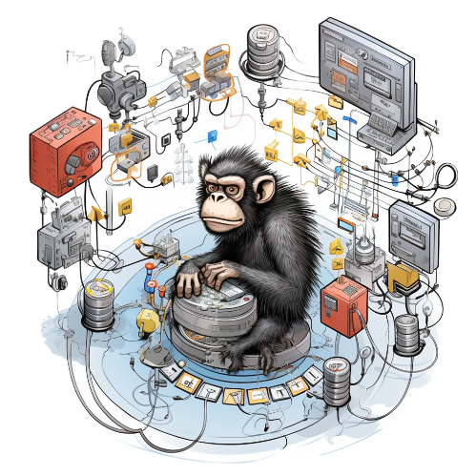

Slide 32
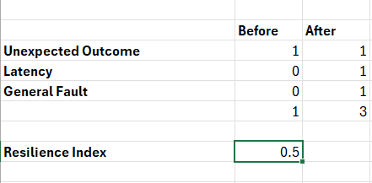

Slide 33
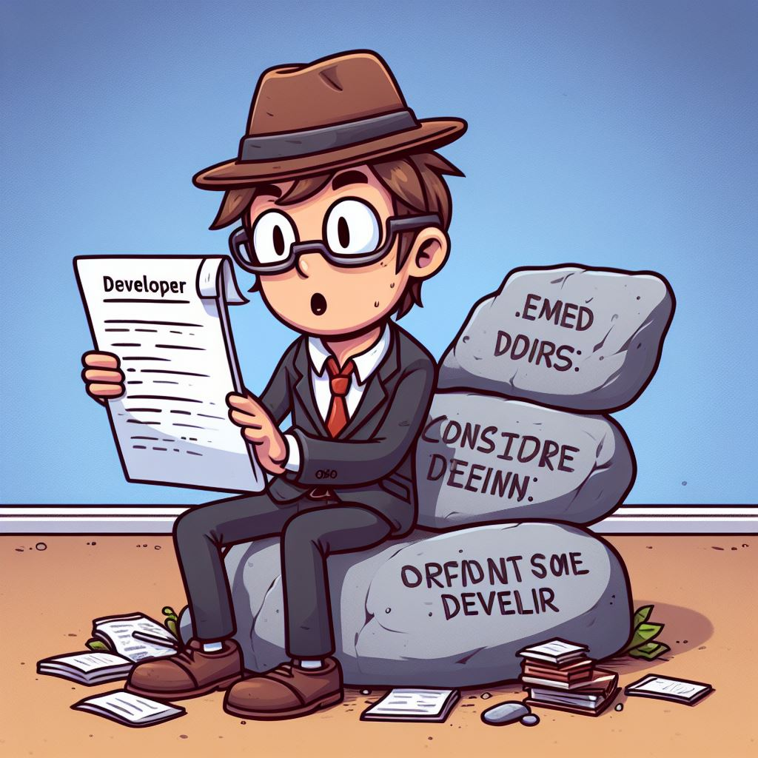
Thank You
alberto.acerbis@intre.it
https://github.com/Ace68/PatternsOfDistributedSystems
https://github.com/ace68

