Slide 1
Advanced Refactor Using DDD
https://github.com/BrewUp/DDD-Europe-2025

Slide 2
Not THE solution, but A solution
Disclaimer
Our Context
We're sharing what worked for us, not a universal approach
Solutions adapt to team size, tech stack, and business domain
Your Mileage
Take principles, adapt implementation to your needs
Notes:
Quando si fanno le scelte bisogna sempre considerare i pro ed i contro delle scelte

Slide 3
What define a legacy system?
Are you sure it is not just old?

Slide 4
Redefining "Legacy"
Not Just Age
It's About Health
Key Indicators
A 20-year system can be healthy
Measures adaptability, not birthdate
Fear of changes
A 2-year system can be legacy
Reflects organizational knowledge
Unknown dependencies
Tribal knowledge

Slide 5
Why do we touch it anyway?
Because duct tape and prayers stopped working

Slide 6
Why do we touch it anyway?
It’s business-critical Because if it goes down, so does half the company...
It’s blocking change Because trying to build around it feels like coding in a minefield
It’s too risky to ignore It’s not a ticking time bomb — it’s already ticking and smoking
It’s costly to maintain Because Karen from finance won’t stop emailing us
It holds valuable data or logic Because it knows things... ancient, forbidden things no one documented
Modernization effort We called it “phase one” in 2019. We still do…
New features Because the shiny new microservice can’t do anything without this dinosaur.

Slide 7
Legacy is not when it is old, but when no one dares to change it anymore.

Slide 8
Awful monolith
Show me the code

Slide 9
Exercise
What is wrong with branch-01?
Notes:
Inseriamo il concetto di modulare (quantum architecture)

Slide 10
“Developers are drawn to complexity, like moths to a flame, often with the same outcome” Neal Ford

Slide 11
Big ball of mud
Lack of a clear architecture, leading to a system that is haphazardly structured and difficult to understand or modify.

Slide 12
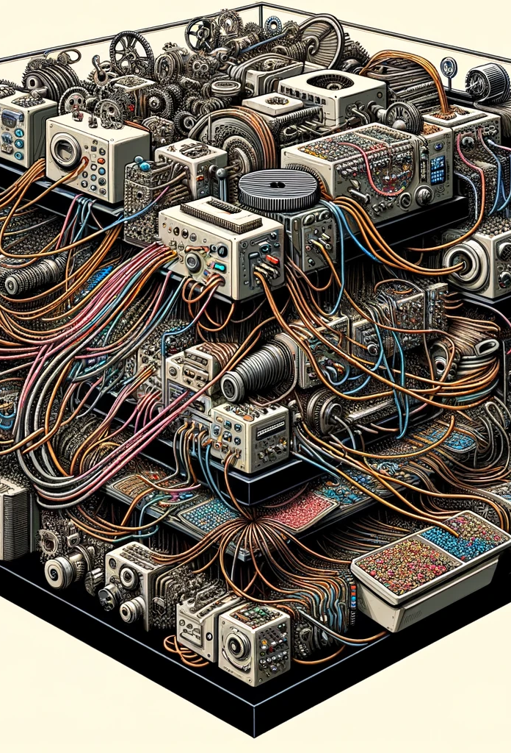
Lack of modularity
Failure to properly encapsulate different functionalities, leading to a system where changes in one module ripple through others.

Slide 13
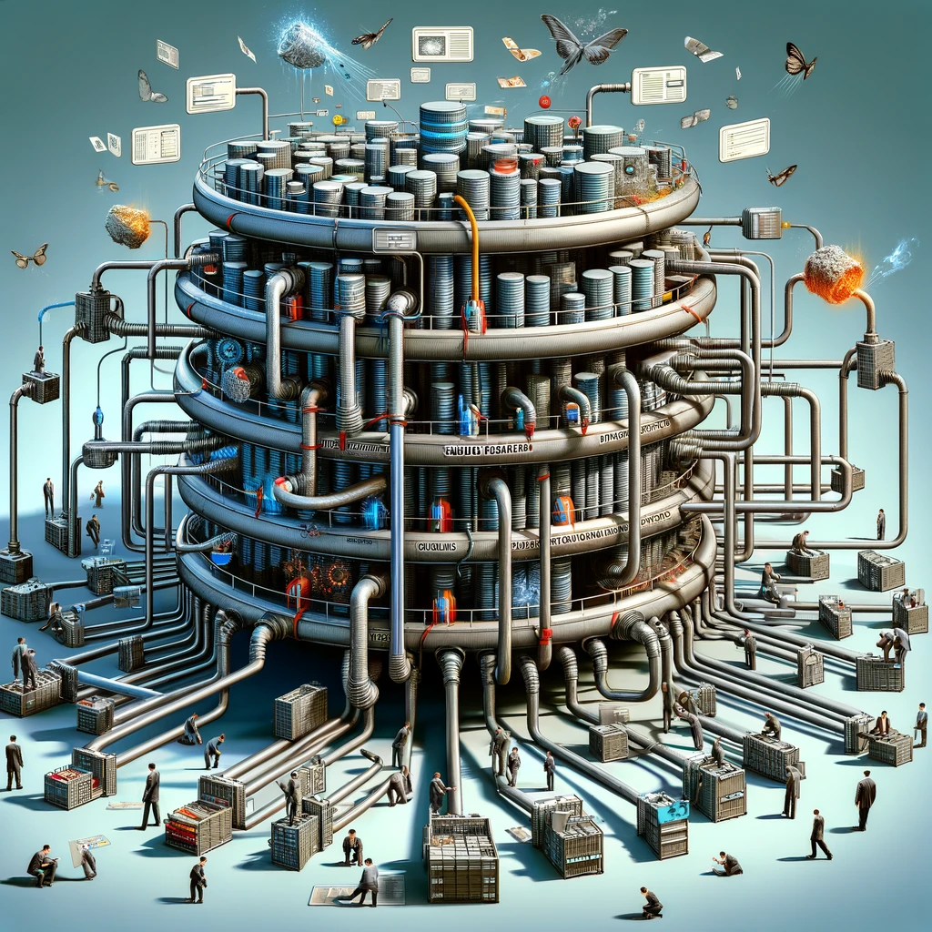
Shared data model
Different modules or functionalities directly accessing and modifying a shared data model, leading to high risk of data corruption and conflicts.

Slide 14
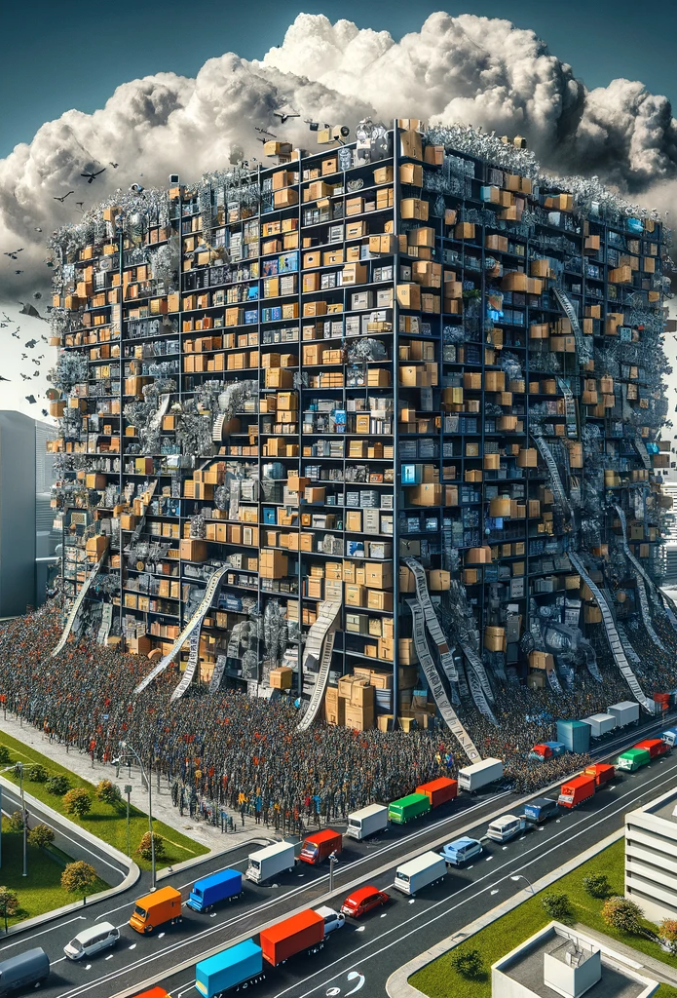
Monolithic database design
A single database for all application needs, creating a bottleneck and complicating any attempt to scale or separate concerns.

Slide 15
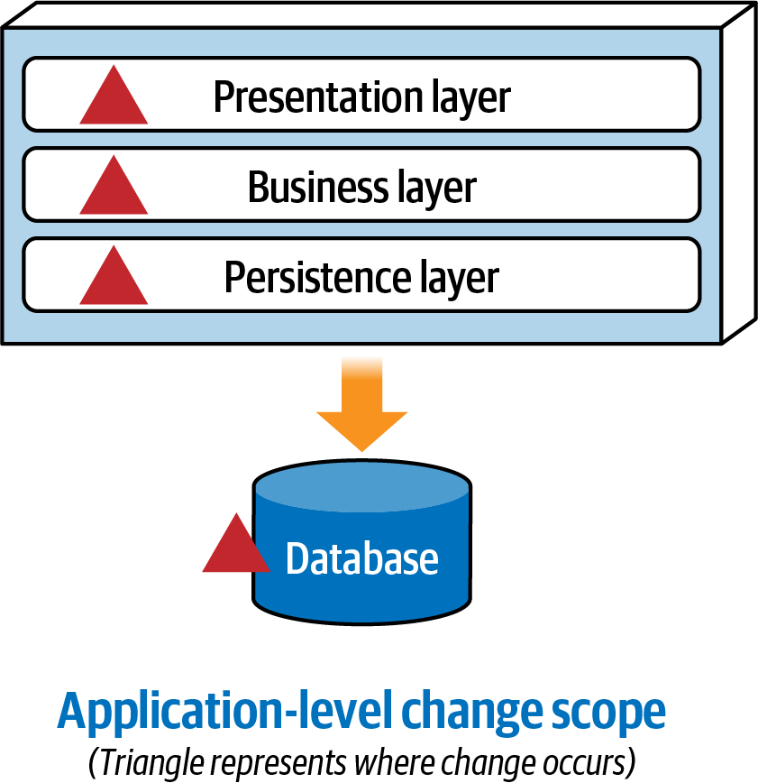
What is the impact of changes?
Neal Ford, Mark Richards, Pramod Sadalage, and Zhamak Dehghani

Slide 16
Exercise
Let’s start refactoring (branch-02)
Notes:
Inseriamo il concetto di modulare (quantum architecture)

Slide 17
Other things we can do?
A DB for every module: Autonomy vs Consistency
Mediator pattern: Decoupling vs Verbosity
Notes:
SPIEGARE che sono scelte che non precludono una o l’altra

Slide 18
Disclaimer
Every solution has a price.
Don't pair up with the first CQRS that comes along.
Notes:
quando si fanno le scelte bisogna sempre considerare i pro ed i contro delle scelte

Slide 19
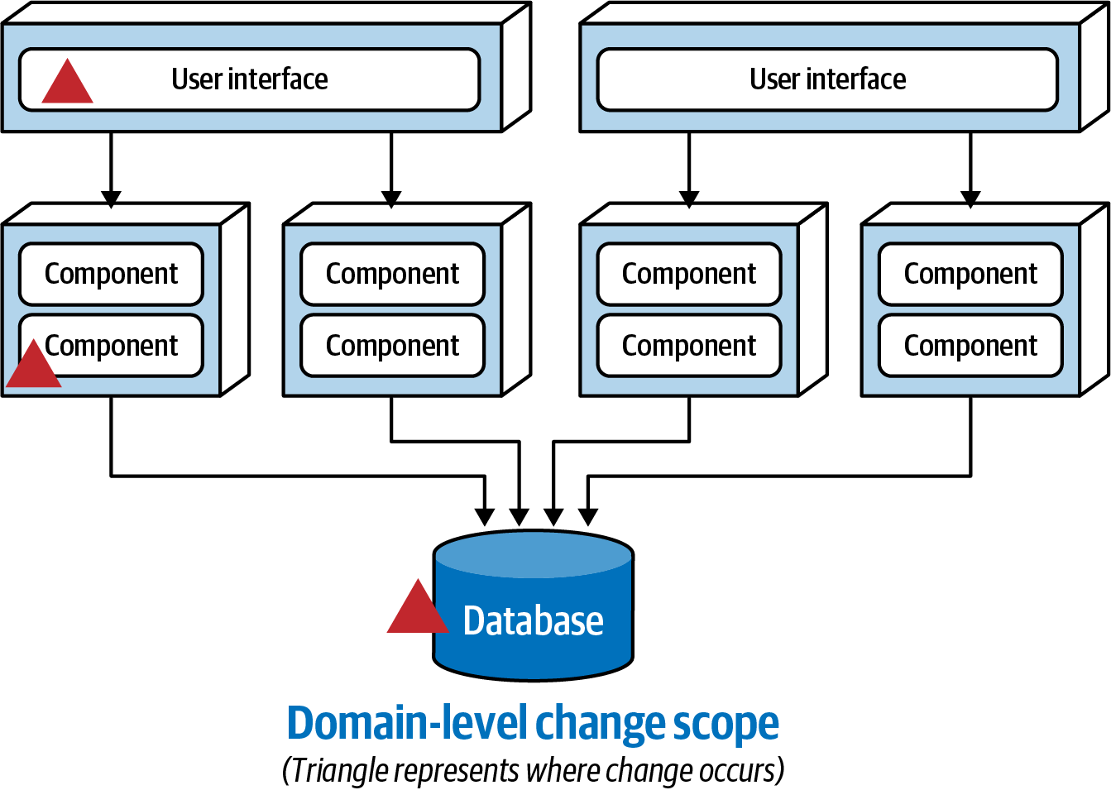
What is the impact of changes?
Neal Ford, Mark Richards, Pramod Sadalage, and Zhamak Dehghani

Slide 20
Exercise
How do you protect yourself?
Notes:
Inseriamo il concetto di modulare (quantum architecture)

Slide 21
Testing strategy: E2E
Validate external behavior
Same payloads, same outcomes

Slide 22
Testing Strategy: Fitness Functions
Assert architectural rules
Protect module boundaries
“Any mechanism that performs an objective integrity assessment of some architecture characteristics or combination of architecture characteristics.” Building Evolutionary Architectures

Slide 23
Testing Strategy: Unit Tests
Pyramid structure
Fast feedback for domain logic

Slide 24
Need More Scalability? How do you achieve that without microservices?

Slide 25
Exercise
Let’s add events! (branch-03)
Notes:
Inseriamo il concetto di modulare (quantum architecture)

Slide 26
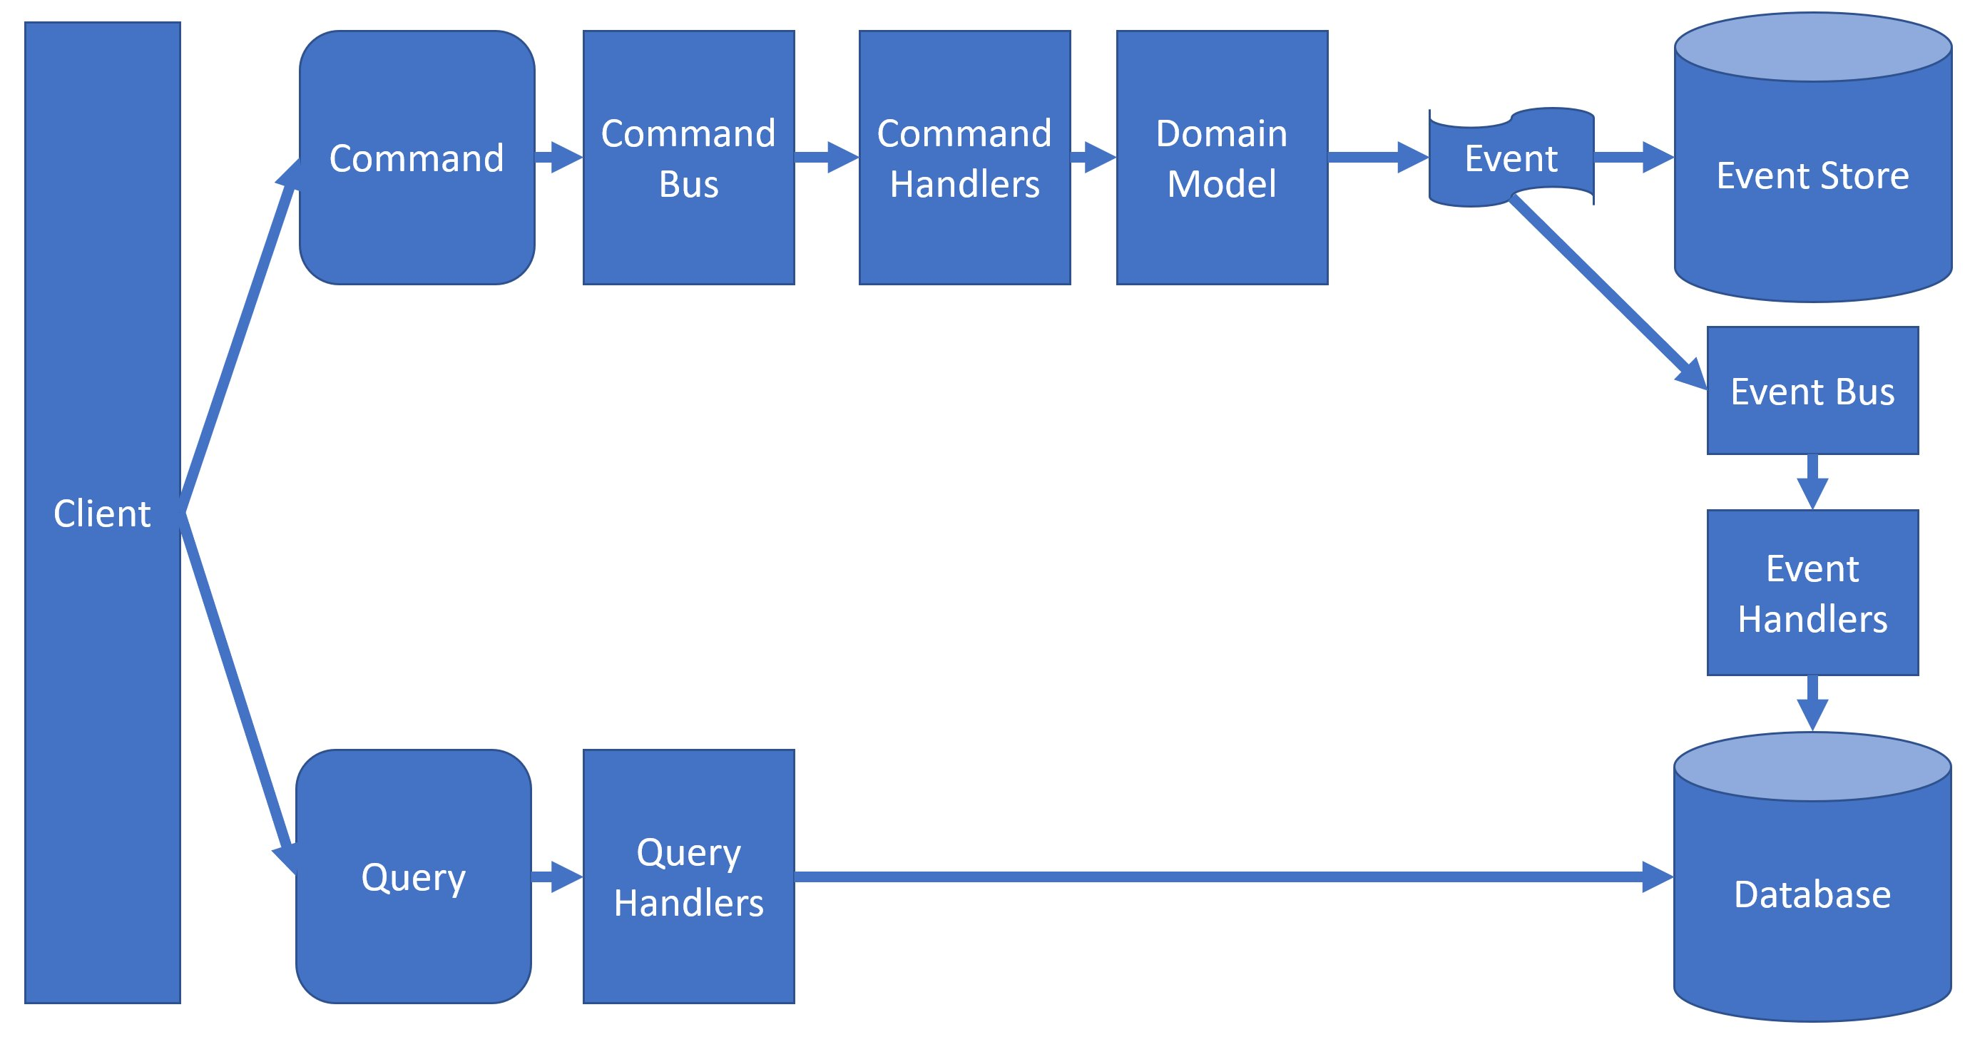
CQRS+ES

Slide 27
Given, When, Then
The essential idea is to divide a scenario into three sections:
Given: describes the state of the aggregate before sending the command. A kind of prerequisite of the test.
When: represents the command to be sent to the aggregate.
Then/Expect: describes the state changes expected as a result of the command.

Slide 28
“Software architecture it's abstract by nature and we must ground it with some implementation details to make it concrete”

Slide 29
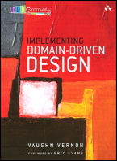
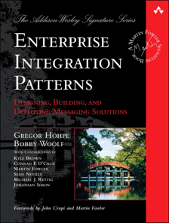
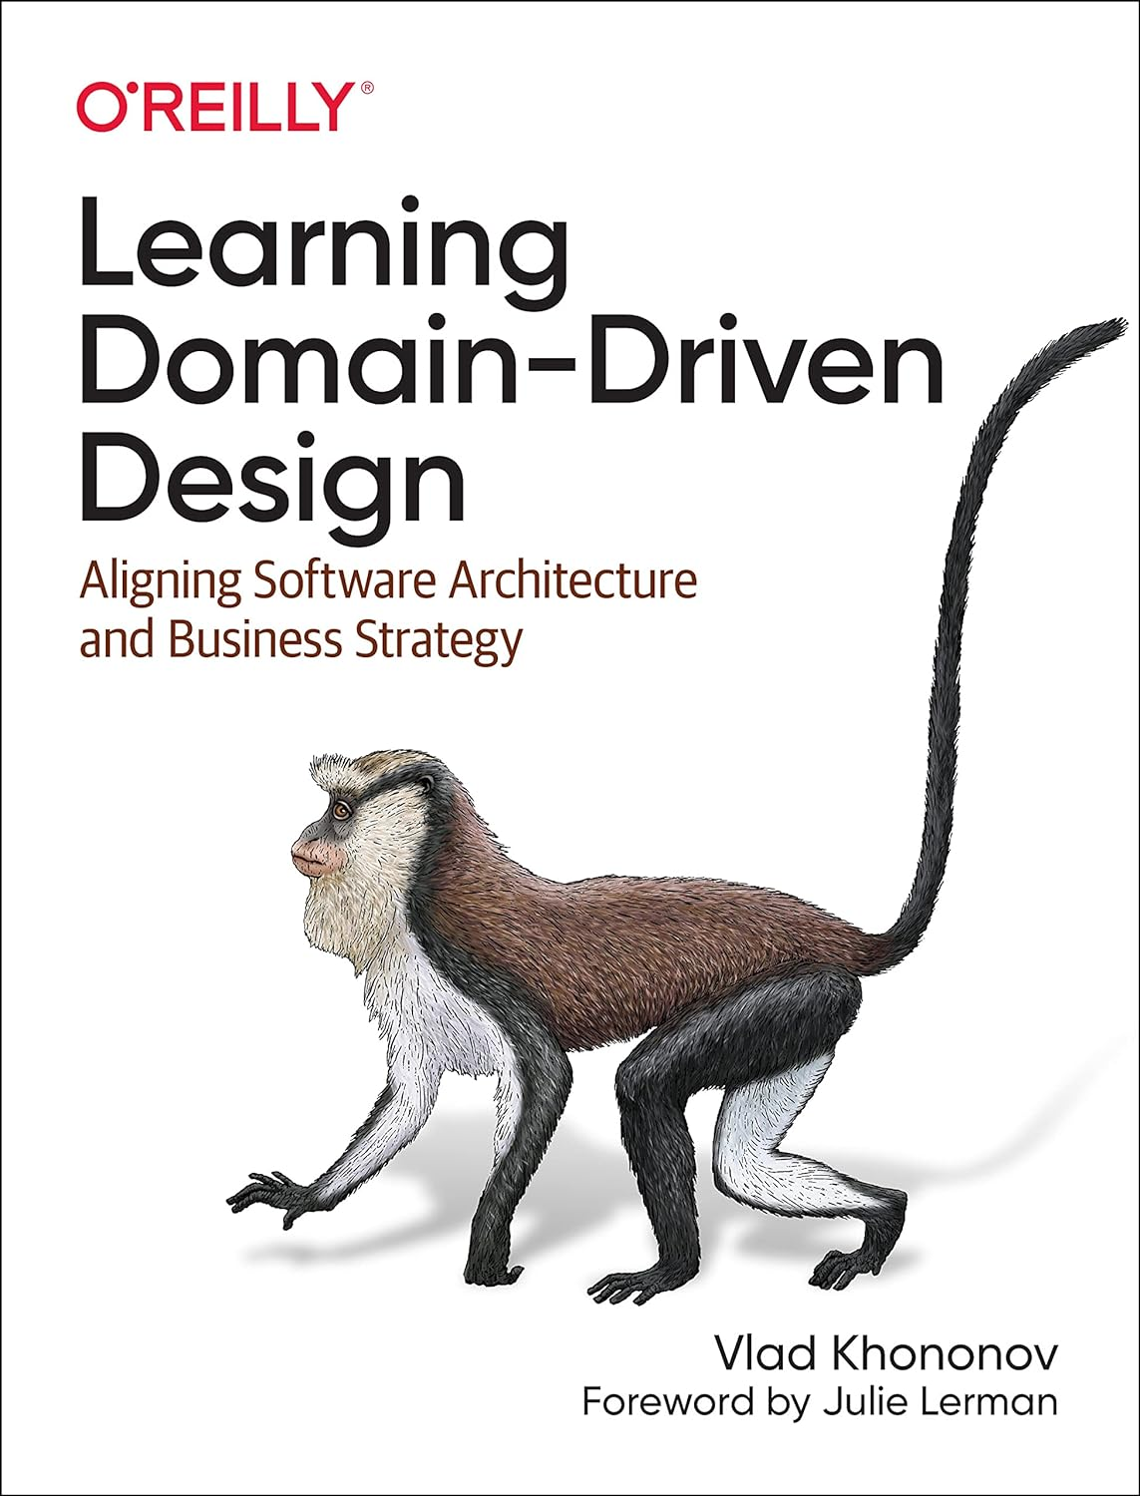
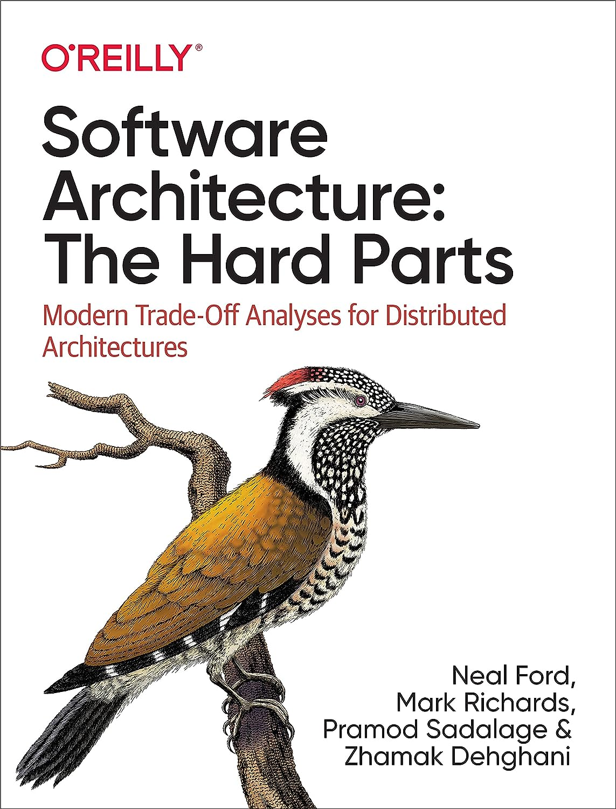
Bibliography
Implementing Domain-Driven Design
The Software Architect Elevator
Learning Domain-Driven Design: Aligning Software Architecture and Business Strategy
Hands-On Domain-Driven Design with .NET Core
Software Architecture: The Hard Parts

Slide 30
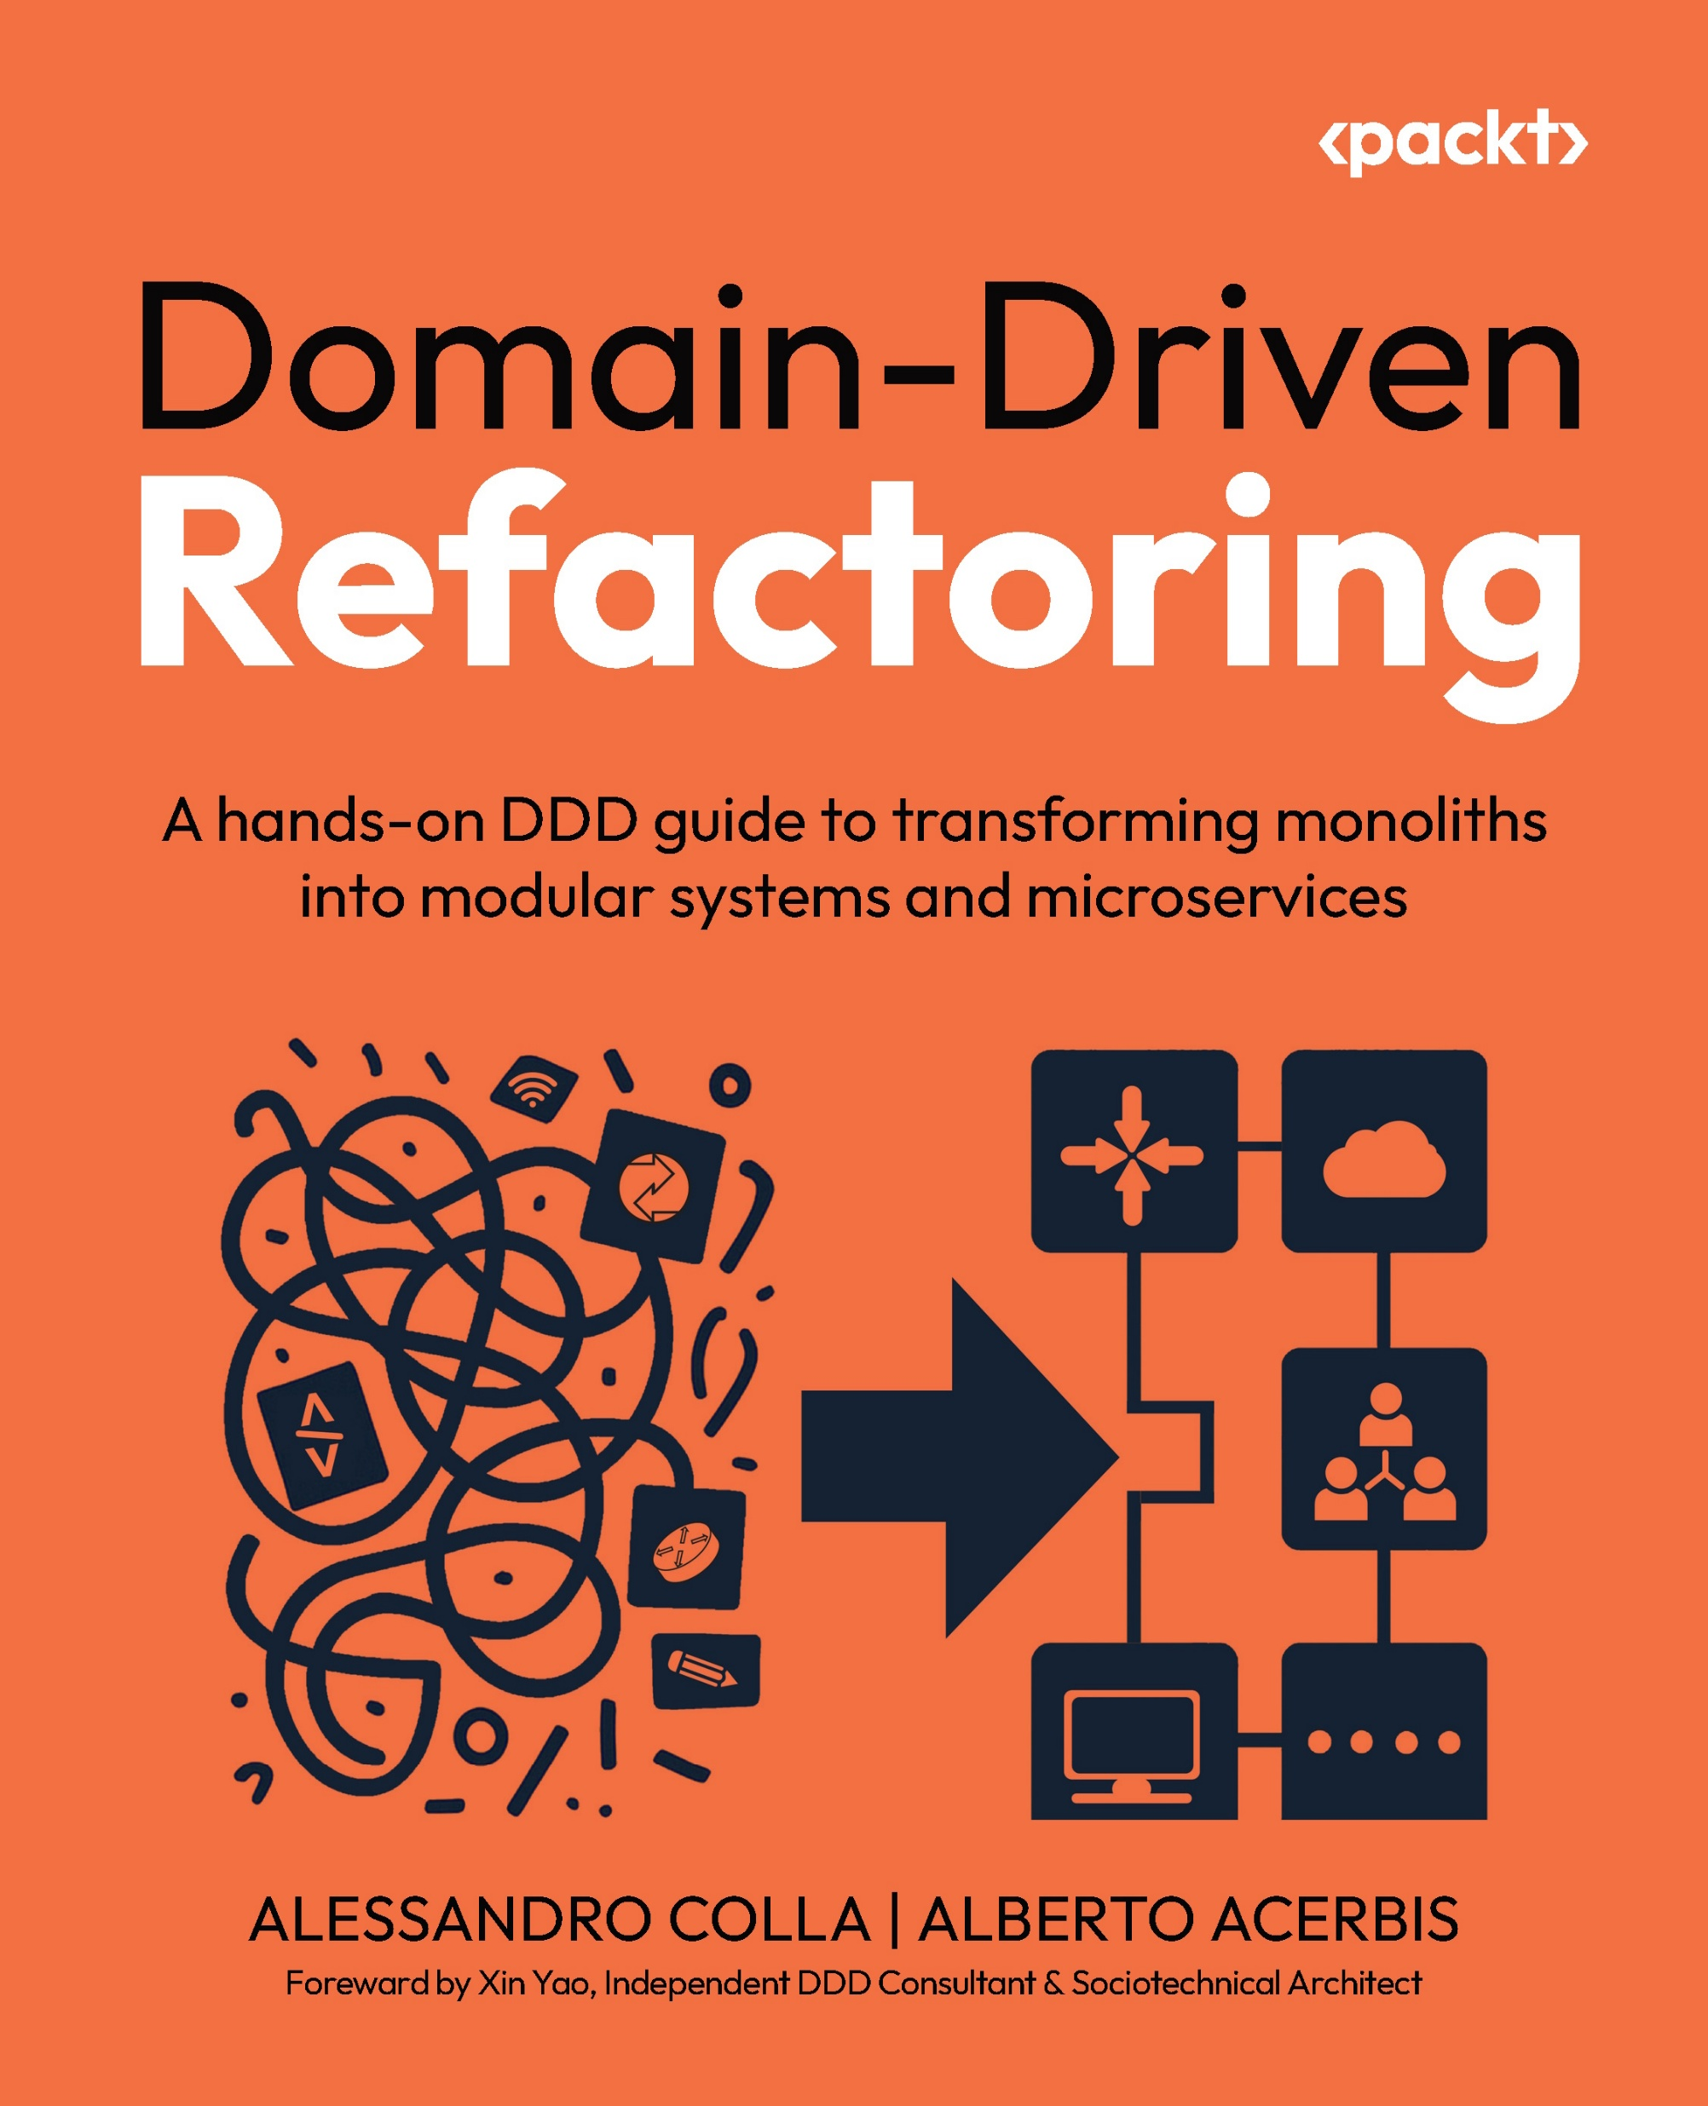
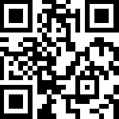
This workshop was based on the concepts explained in our recently released book
Use DDD20 for a 20% discount during the conference days

Slide 31
Thank you! We hope you learned something while having fun
linkedin.com/in/aacerbis/
alberto.acerbis@intre.it
linkedin.com/in/alessandrocolla
alessandro.colla@evoluzione.agency

