Slide 1


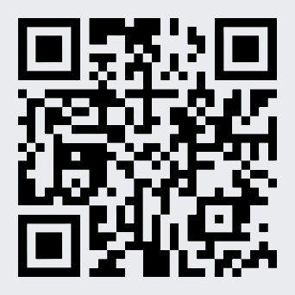
Spec-Driven Development
Redefining the Software Architect in the AI Era
Alberto Acerbis · Alessandro Colla
https://github.com/BrewUp/DWX26

Slide 2
The Promise
AI promises to make software development easier.
The hard part is making intent survive generation.
We believe the first sentence.
This talk is about the second.
Notes:
In reality it’s prompt and pray

Slide 3
A new BrewUp feature
feature request
Implement order confirmation for BrewUp.
An order can be confirmed when:
- the customer payment has been authorized;
- all requested beers are available in the warehouse.
When the order is confirmed, reserve the stock.
Sales
Warehouse
Payment
commercial commitment
physical stock
authorization · new for this story

Slide 4
Let’s see what happens

Slide 5
The generated feature
Polished, compiles, tests green.
SalesOrder
SalesOrder.cs
SalesOrder
PaymentAuthorizationId?
StockReservationId?
ConfirmOrder(...)
also generated:
+ SalesOrderConfirmed event
+ ReserveItemStock command
+ handlers, read models, tests
internal void ConfirmOrder(
PaymentAuthorizationId paymentAuthorizationId,
StockReservationId stockReservationId,
Guid correlationId)
{
...invariants check...
RaiseEvent(new SalesOrderConfirmed(
new SalesOrderId(Id.Value),
paymentAuthorizationId,
stockReservationId,
correlationId));
}
Notes:
- Concetto di payment non ha chiesto nulla
- ha creato solo il PaymentAuthorizationId e lo ha messo in shared
- no modulo dedicato per il pagamento
- possiamo aggiungere una nota su implicito ed esplicito

Slide 6
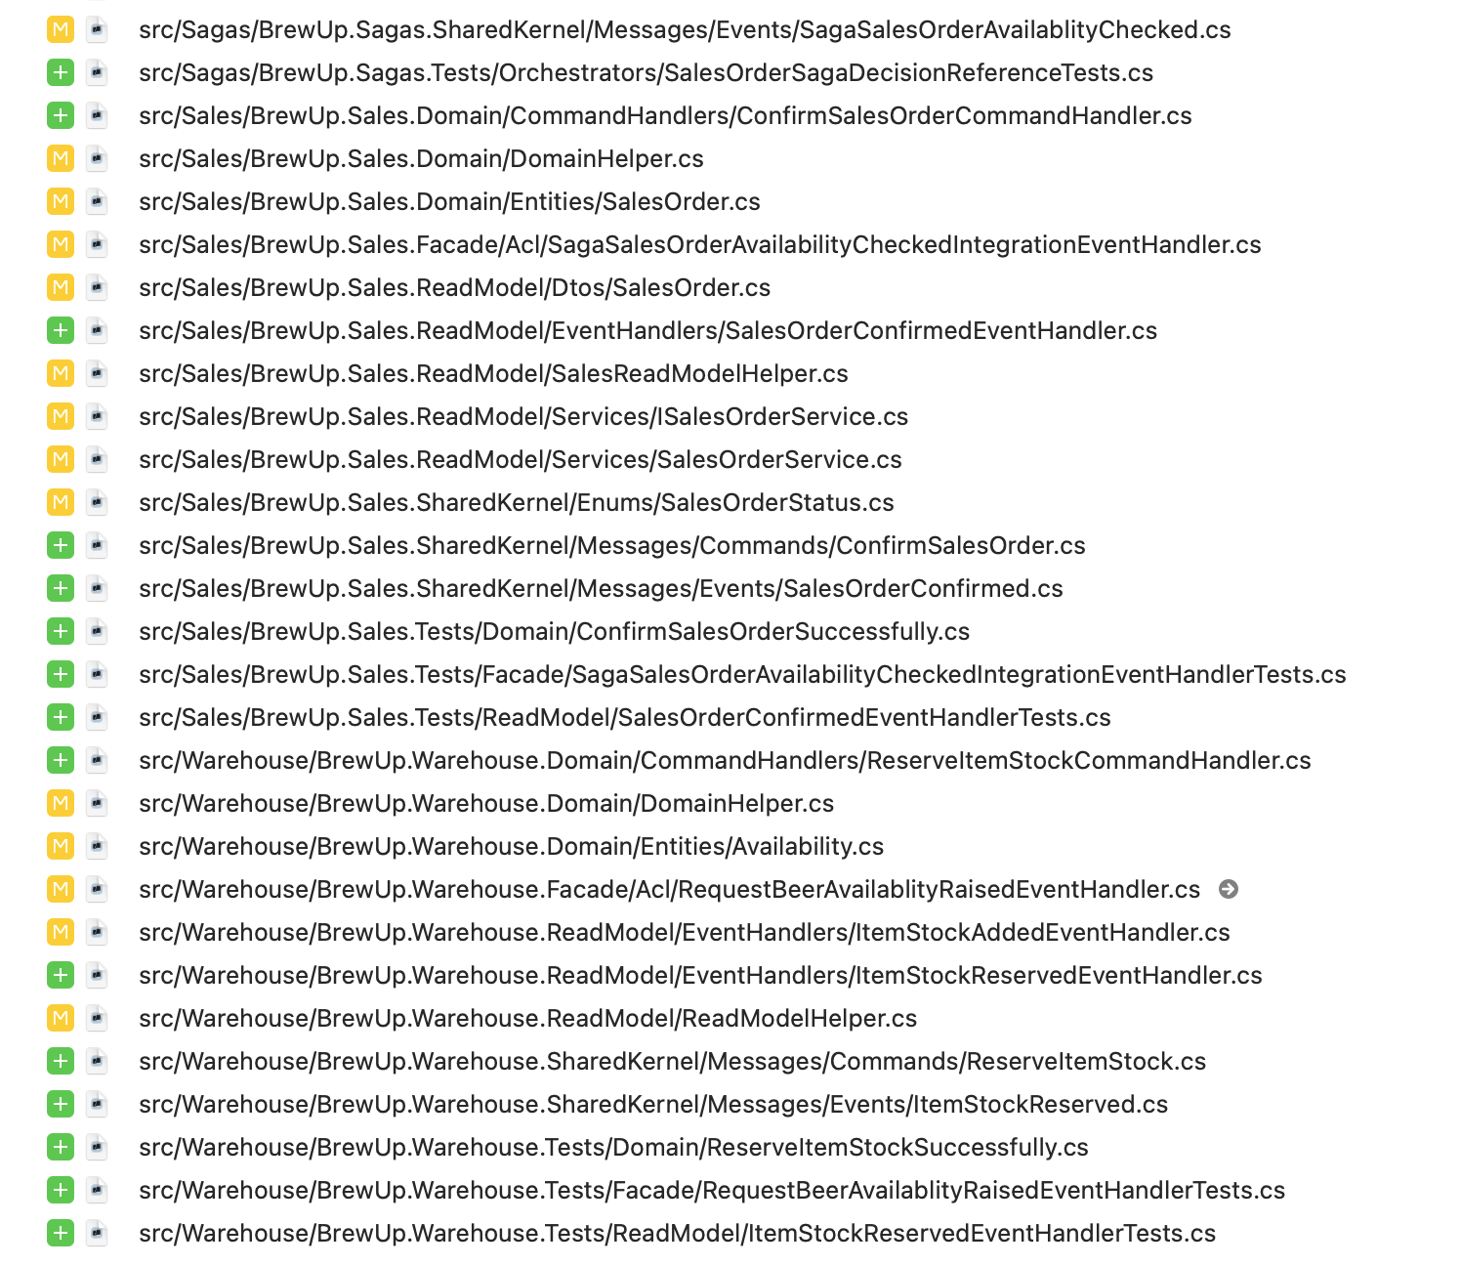
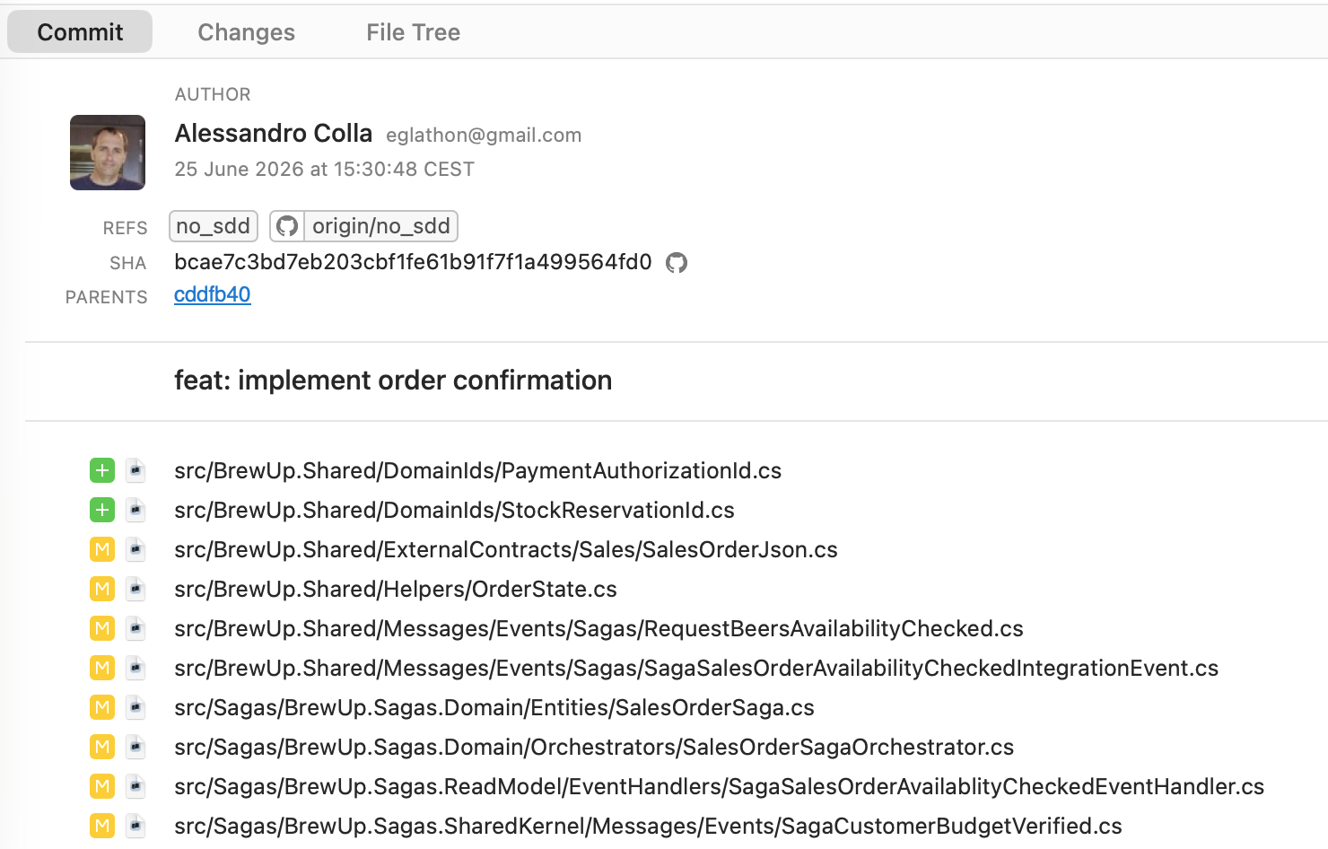
The generated feature
Compiles and tests are green. --> 39 files touched with 14 new files
Just one commit
Notes:
- Concetto di payment non ha chiesto nulla
- Ha creato solo il PaymentAuthorizationId e lo ha messo in shared
- No modulo dedicato per il pagamento
- Possiamo aggiungere una nota su implicito ed esplicito

Slide 7
Would you approve this PR?
Notes:
3 secondi di pausa per l’effetto

Slide 8
One aggregate, three authorities
Sales
Payment
Warehouse
owns the commercial commitment
owns payment authorization
owns physical stock
DDD speaking, Payment is implicit and not explicit.
Notes:
Dependency on a decision is not ownership of the decision.
Where are the aggregates boundaries???

Slide 9
The right nouns, invented evidence
The references look right. The evidence is manufactured by the workflow.
where the ids come from?
// saga
new PaymentAuthorizationId(correlationId.ToString());
// warehouse ACL
new StockReservationId(Guid.CreateVersion7().ToString());
An id — but no Payment authorization decision
An id — but no Warehouse reservation lifecycle
An identifier is not evidence unless the owning authority produced the decision it refers to.
Notes:
11:00–14:00 · Lead Alessandro. The names are correct, but the saga mints the PaymentAuthorizationId from the correlation id and the Warehouse ACL mints the StockReservationId from a Guid. BUILD: click 1 reveals that the ids are hollow + the key line.

Slide 10
One transaction?
Authorize payment
+
Reserve stock
+
Confirm Sales Order
=
One transaction?
Payment authorized
Stock reservation failed
Several policies are plausible. None is correct until someone with domain authority decides.
Notes:
14:00–17:30 · Both. Audience interaction 2. Break the line between Payment and Warehouse; add failure in coral. Do not display the 'correct' policy.

Slide 11
A longer prompt?
Conversation A
Conversation B
Conversation C
prompt v1
prompt v2
prompt v3
Synchronized copy and paste is not governance.
Every new session does not consider previous ones.
Notes:
Specificare bene che gli LLM rileggono sempre tutto
Vibe coder situation. After 700 prompts…I’m just one prompt away the thing I want

Slide 12

From prompting
to engineering discipline.
Used in this story
Constitution → specify → clarify → plan → task → implement
Notes:
A software engineering methodology where a highly detailed, structured specification (a "spec") is written before any code is generated
Dire che diamo disciplina al casino di prima con SDD e che usiamo speckit solo come esempio (ci sono mille framework)
Dire che constitution contiene le regole che il bot deve rispettare
Dire che constitution è la memory bank (se uso fw differente)

Slide 13
Prompt versus specification
Prompt | Specification
Requests an output | Records a decision
Lives in a conversation | Lives with the system
May be copied | Is referenced and checked
Invites assumptions | Makes constraints explicit
A prompt asks for an output.
A specification records decisions that subsequent outputs must respect.
Notes:
Spec-driven nato nel 2025
Facciamo esempi con SpecKit, ma ce ne sono mille altri che sono nati dopo

Slide 14
spec.md
Language and ownership become durable.
/speckit.specify · Ubiquitous Language
memory · Bounded Context Rules
Sales Order
A commercial commitment
made by a customer.
Payment Authorization
An outcome produced by Payment.
Stock Reservation
An outcome produced by Warehouse.
BC-004
Payment Authorization is produced by
Payment. Sales stores the id as evidence.
BC-006
Stock Reservation is produced by
Warehouse. Sales stores the id as evidence.
BC-011
The agent MUST NOT invent timeout,
retry, expiry, void or release policy.
Notes:
Mostrare spec.md vero

Slide 15
Where humans must decide
/speckit.clarify
The agent may identify the ambiguity.
1. Confirmation sequencing (OQ-1 / FR-010)
2. Payment authorized but stock not reservable (OQ-2 / FR-011)
3. Partial reservation and the confirmation invariant (OQ-3)
The domain expert must resolve it.
The specification must preserve
the resolution.
Notes:
27:30–31:00 · Both. Audience interaction 3. BUILD: reveal one line per click (one per speaker) — agent identifies / expert resolves / spec preserves.

Slide 16
Let’s plan and watchout for tokens cost!
/speckit.plan
This is the moment where we choose the tech stack and we create the implementation plan
As per /specify, we suggest to use a powerful frontier model to generate the plan

Slide 17
Create the tasks list
/speckit.task
Generate actionable task lists for implementation
Also, here we prefer to use a powerful frontier model
Notes:
Dire che dobbiamo fare un test per usare haiku, perché i token costano

Slide 18
Start to code
/speckit.implement
Execute all tasks to build the feature according to the plan
We can use a very cheap model because it just has to write code following strict rules

Slide 19
What is the result?
Show me the code!

Slide 20
Behaviour before mechanism
Specification | Plan
What must happen? | How is it coordinated?
Who owns the decision? | Which component coordinates?
Which outcomes are valid? | Events, retries, process manager?
What happens on failure? | Which technical mechanism?
SDD prevents technical design from silently inventing domain behaviour.
AI is not your senior architect. It’s a very fast junior with no memory of your business, no taste, and no shame.
Notes:
Non serve spiegare nulla perché lo avete visto nel codice prima

Slide 21
The implementation still violated the specification
It has the two references we asked for — but the workflow manufactured them.
// saga
var paymentAuthorizationId =
new PaymentAuthorizationId(
correlationId.ToString());
// warehouse ACL
StockReservationId stockReservationId =
new(Guid.CreateVersion7().ToString());
reserveCommands.Add(new ReserveItemStock(...));
Invented evidence
Payment did not produce the authorization. Warehouse did not define a reservation lifecycle.
The id was minted, not earned.

Slide 22
Make architectural drift visible
/speckit.analyze
CRITICAL — Invented external decision evidence
PaymentAuthorizationId and StockReservationId are recorded, but their domain meaning is not produced by the owning authorities recorded in the specification.
BC-003 Payment owns authorization outcomes.
BC-004 Payment Authorization is produced by Payment.
BC-006 Stock Reservation is produced by Warehouse.
BC-007 Warehouse owns physical stock and reservations.
BC-011 The agent must not invent reservation lifecycle,
timeout, retry, void or release policy.
SDD does not guarantee obedience. It makes architectural drift inspectable.

Slide 23

New requirement
Approved wholesale customers may order using pre-approved payment terms.
No immediate payment authorization is required.
Notes:
41:30–43:30 · Lead Alessandro then Alberto. Speaker roles reverse. A small exception changes the decision model.

Slide 24
What changes first?
The specification changes first — and shows the blast radius.
A
Specification
spec.md · Confirmation Policy
Confirmed when:
- stock has been reserved
- either payment is authorized
or valid payment terms are recorded.
B
Plan
C
Code
/speckit.analyze · after the change
HIGH — Requirement no longer covered
Task T-18 requires PaymentAuthorizationId for every Sales Order confirmation.
The evolved spec allows PaymentTermsApprovalId for eligible wholesale customers.
Notes:
Solution space e problem space

Slide 25
The architect as context governor
Still necessary | More explicit with agents
Designing components and boundaries | The same boundaries, encoded as decision authority
Communicating decisions | Decisions made persistent and checkable
Reviewing the design and the code | Reviewing the whole artifact chain
Resolving ambiguity during implementation | Exposing ambiguity before execution
Not deterministic output — verifiable decisions.
The architect designs the context within which the AI is allowed to operate.

Slide 26

A prompt describes a task.
A specification records a decision.
Architecture makes those decisions survive implementation.
The prompt delegates hidden decisions to the model.
The specification make those decisions explicit, reviewable, and ours.

Slide 27
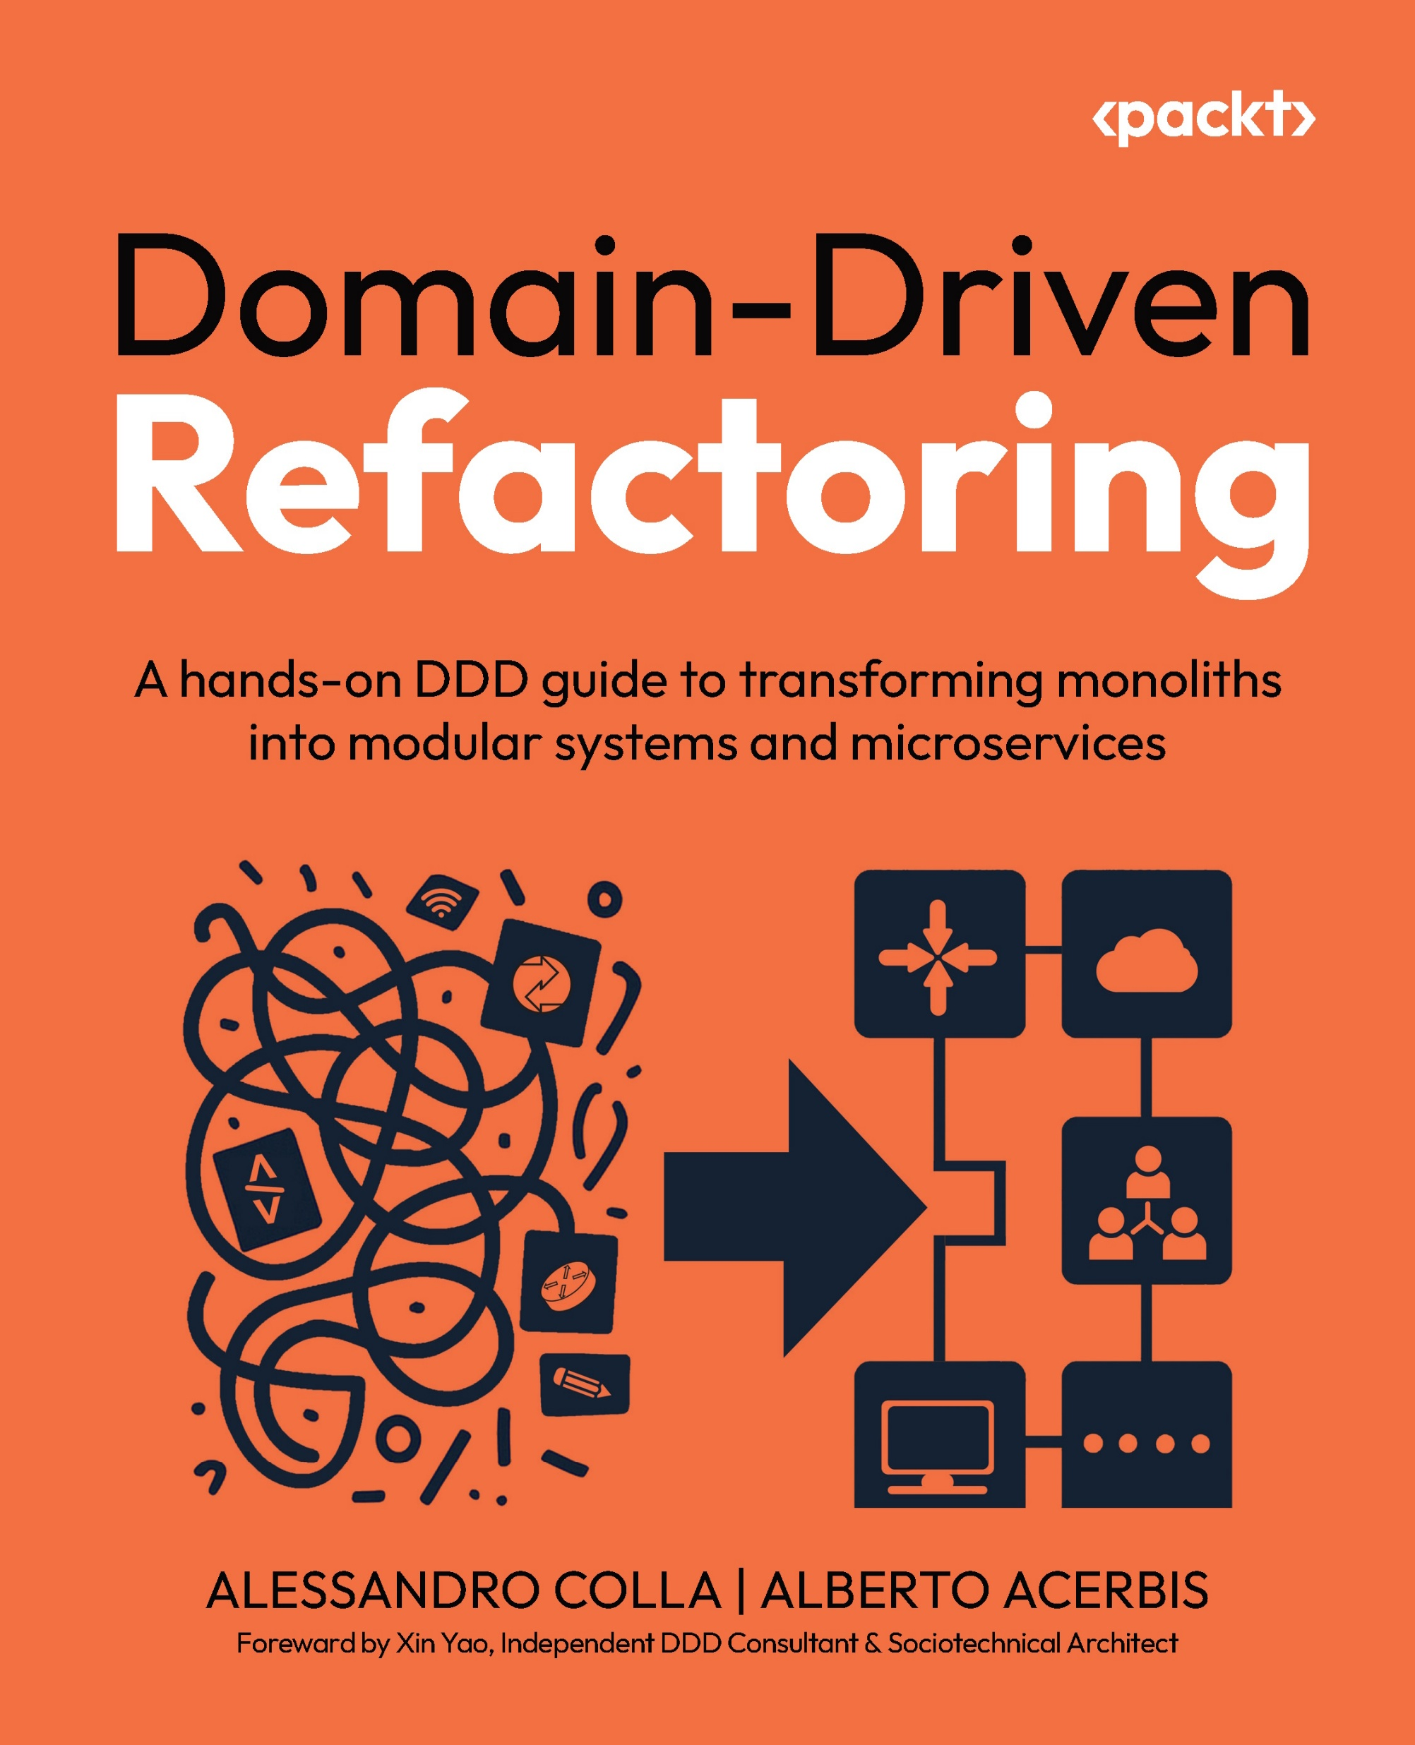




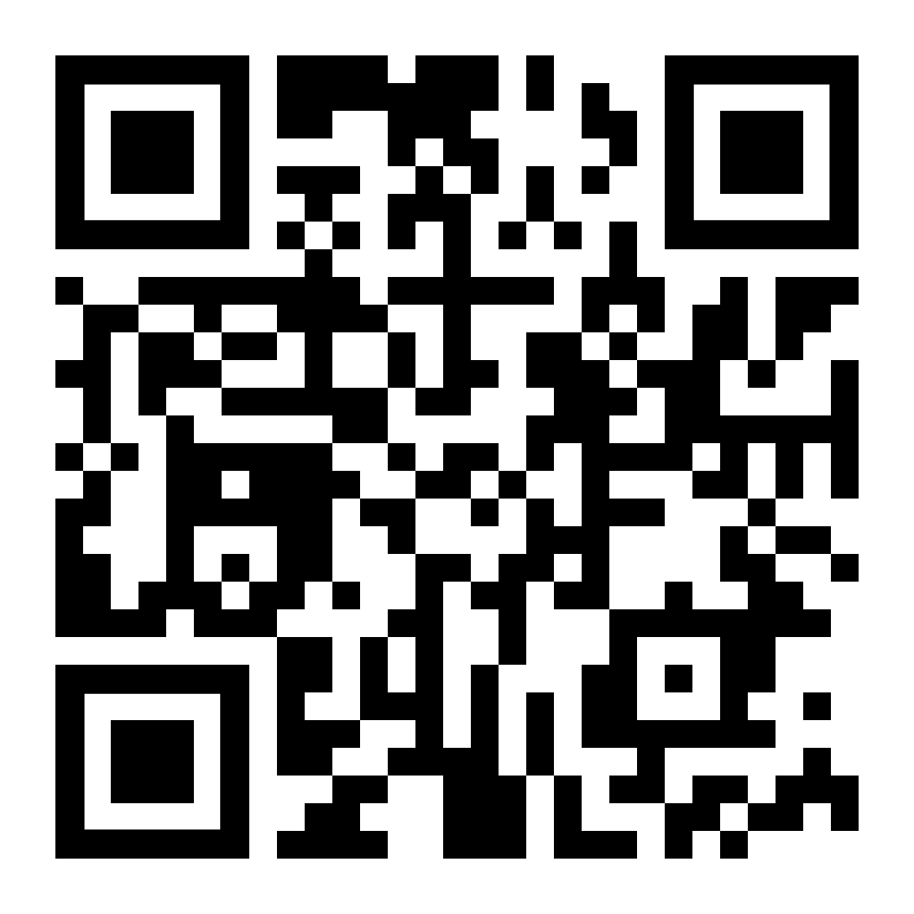
Thanks!
aacerbis
alberto.acerbis@intre.it
alessandrocolla
alessandro.colla@evoluzione.agency
https://github.com/BrewUp/DWX26

