Slide 1
Property Based Testing with .NET
Alberto Acerbis
KeyCrushers @Intré S.r.L. Microsoft MVP

Slide 2
Sponsor

Slide 3
What are the tests for?
Design Tool
High-Quality Product
Cost Efficiency Increasing
Security
Easy adding new features

Slide 4
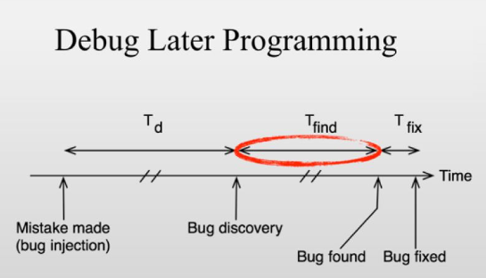
Testing slows down development

Slide 5
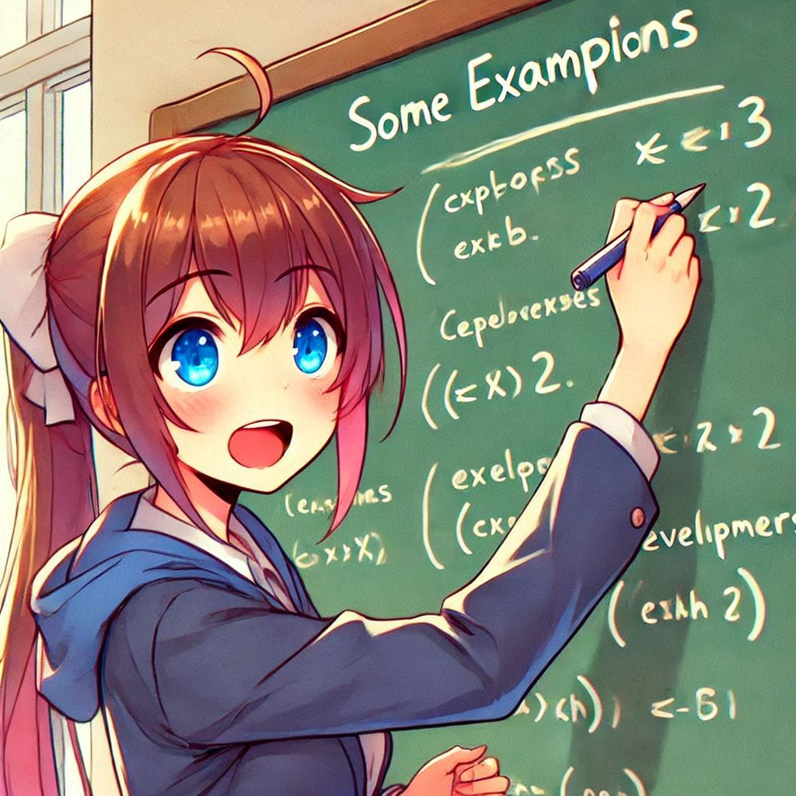
Example-Based Testing
Example-based testing uses individual values
It’s difficult to make sure you’ve covered all the possibilities edge cases
They don’t explain the business intent

Slide 6
Property-Based Testing
It’s a generative testing
You do not supply specific example inputs with expected outputs as with unit tests
You define properties about the code and use a generative-testing engine (QuickCheck in Haskell, FsCheck in F#) to create randomized inputs to ensure the defined properties are correct

Slide 7
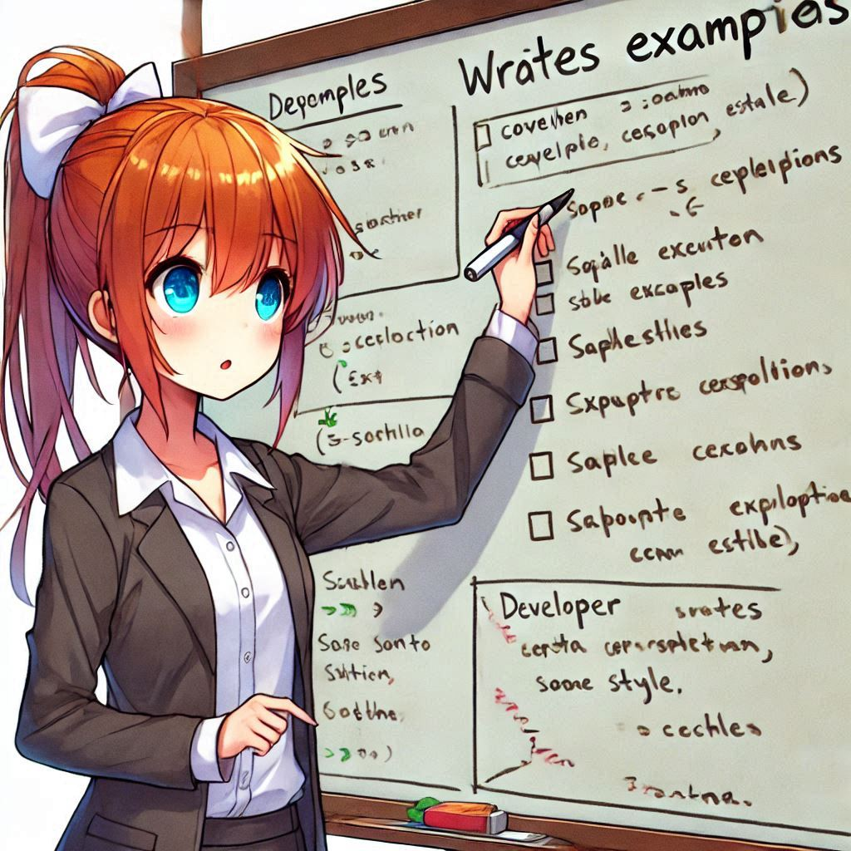
NUnit
NUnit
We are testing so everything is a Test.
A Test that runs many times is a MultiTest.
Data come from a TestCaseData or a TestCaseSource

Slide 8
xUnit loves Property-Based Testing
xUnit
[Fact] is an individual relevant assertion. If you have 3 of them, they may or may not mean anything in aggregate.
[Theory] is a set of [Fact] that together prove an overall concept.
[XData] can be individual case, or an aggregate source (can be singular or plural)
https://xunit.net/docs/why-did-we-build-xunit-1.0

Slide 9
What is a Property?
We don’t mean properties of C# classes.
The term property is used in a more abstract way.
Characteristic, feature, trait …
A property is a condition that will always be true for a set of valid inputs.
It is called that because that's its role - It's not a TestWithMultipleInvocationsBasedOnArbitraryData. We are specifing a property of the system under test.

Slide 10
How to apply Property-Based Testing?
Understand and represent the relationship between inputs and outputs
Use randomly generated inputs to express deterministics outputs
It’s by no means a full replacement!
The best approach is to have the right mix of the two in your suite

Slide 11
The Add method
Commutativity
When you add two numbers, the result should non depend on the order of the parameters
5 + 4 = 4 + 5
5 * 4 = 4 * 5
Associativity
When you three or more numbers, the order of the operations doesn’t matter
(1 + 2) + 3 = 1 + (2 + 3)
(1 * 2) * 3 = 1 * (2 * 3)
Identity
Adding zero is the same as doing nothing
2 + 0 = 2 // true
2 * 0 = 2 // false!

Slide 12
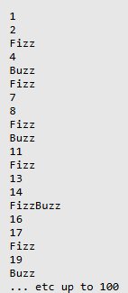
The FizzBuzz
Write a program that prints the number from 1 to 100. But for multiples of three print «Fizz» instead of the number and for multiples of five print «Buzz». For numbers which are multiples of both three and five print «FizzBuzz>

Slide 13
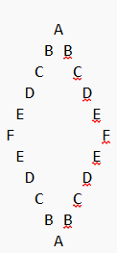
The Diamond
Given a letter, print a diamond starting with «A» with the supplied letter at the widest point
First & last lines contain «A»
All rows, except first and last, contain two identical letters
The Diamond is vertical, and horizontal, symmetric

Slide 14
Pros & Cons
Algoritmi
Sistemi con regole chiare
Librerie matematiche
Sistemi con interfacce grafiche
Sistemi con proprietà difficili da formalizzare

Slide 15
But does anyone use PBT?

Slide 16
Thank you!
alberto.acerbis@intre.it
https://github.com/Ace68/PropertyBasedTest
Alberto Acerbis

